Slide 1
Evolution: Evidence of Change
Evolution and Life’s diversity
The Age of the Earth
The Fossil Record
Evidence from Living Organisms

Slide 2
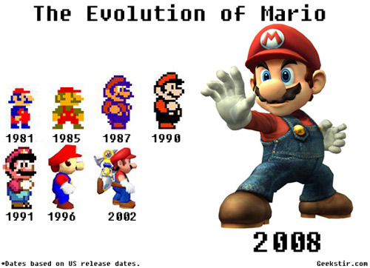

Slide 3
Evolution and Life’s Diversity
Darwin’s Dilemma
The Diversity of Life
Fitness: To Survive and Reproduce

Slide 4
Life changes over time, or evolves.
Not enough to make evolution a science
Constant testing of hypotheses must replace belief
Scientists have accumulated evidence to show that organisms alive today have been produced by a long process of change over time
Evolution
Charles Darwin

Slide 5
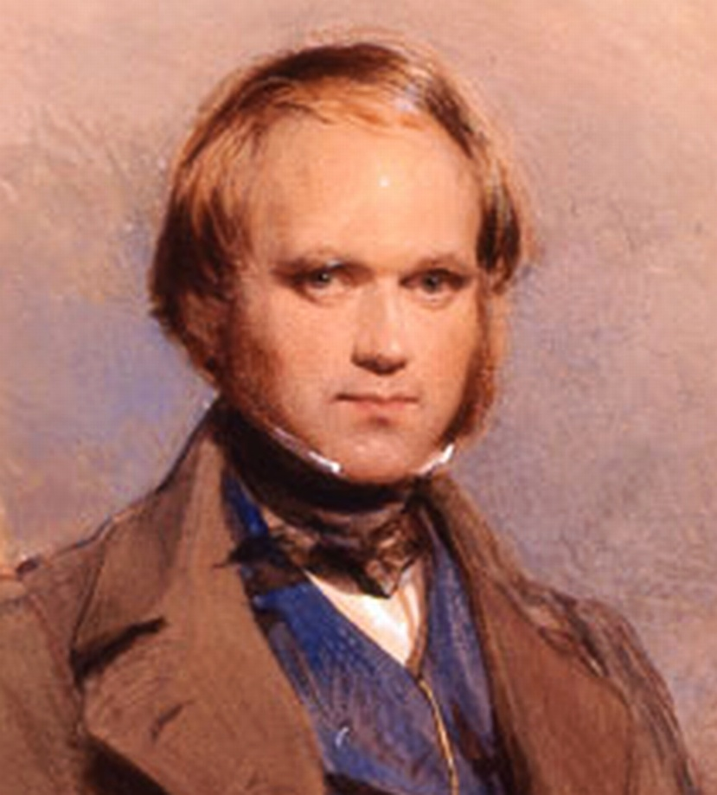
Darwin’s Dilemma
Two days after Christmas in 1831, a young Englishman set sail on HMS Beagle for a cruise around the world
Charles Darwin
Revolutionize scientific thought

Slide 6
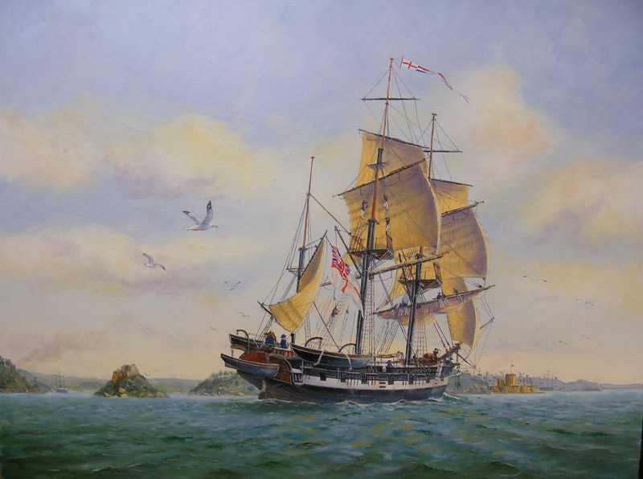
Darwin’s Dilemma
Over 5 years, Darwin visited several continents and many remote islands
At each new place, he collected animal and plant specimens
Witnessed countless wonders of nature

Slide 7
The Diversity of Life
Diversity of life=variety of living things
Still discovering new organisms
Darwin discovered not just current life but evidence of past life
Several species have come and gone
Where have all the organisms come from?
Why have so many disappeared over time?

Slide 8
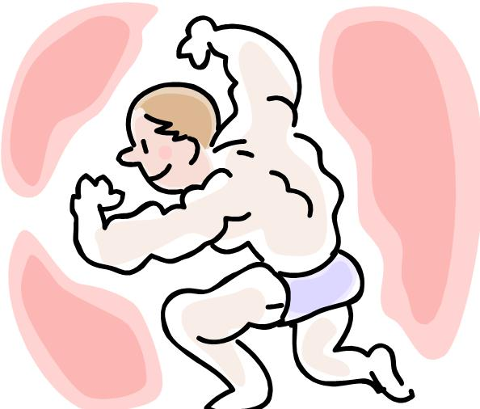
Fitness: To Survive and Reproduce
Darwin was impressed by the many different ways organisms survive and reproduce
fitness= the physical traits and behaviors that enable organisms to survive and reproduce in their environment
How did organisms develop the structures that give them their fitness?
Why are there so many different techniques for survival?

Slide 9
Fitness: To Survive and Reproduce
In 1859, 30 years after Darwin began his voyage, he published his explanations in a book called The Origin of Species by Means of Natural Selection
This book changed the way people think about the living world

Slide 10
Fitness: To Survive and Reproduce
Darwin’s book stated that modern organisms were produced by a process called evolution
Process of change in species over time
Organisms come from preexisting organisms and each species has descended from other species
All species have shared (common) ancestors= common descent

Slide 11
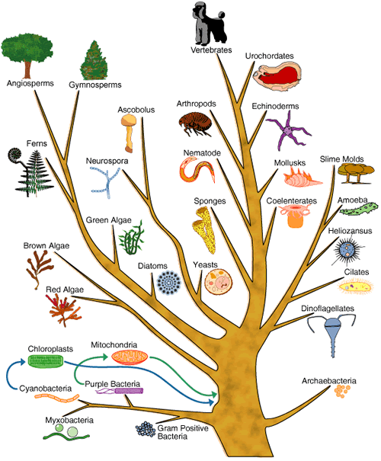

Slide 12
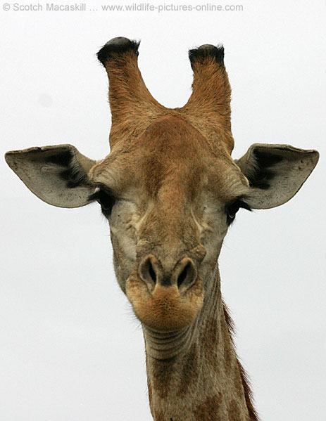
Fitness: To Survive and Reproduce
Fitness arises through adaptations
Adaptation= process that enables organisms to become better suited to their environments
Any inherited characteristic that increases an animal’s or plant’s fitness for survival
Long neck and legs of a giraffe
Sphinx moth long feeding tube
Vampire bat teeth

Slide 13
The Age of the Earth
Evidence in Stone
The Geologic Time Scale: A Clock in the Rocks
Radioactive Dating

Slide 14
Some evidence of evolution suggests that planet Earth is more than 4 billion years old
Other evidence makes it clear that both Earth and the life on it have changed dramatically over time
Other evidence supports the principle of common descent and emphasizes the importance of adaptation to the environment
Much evidence is found in the rocks of Earth

Slide 15
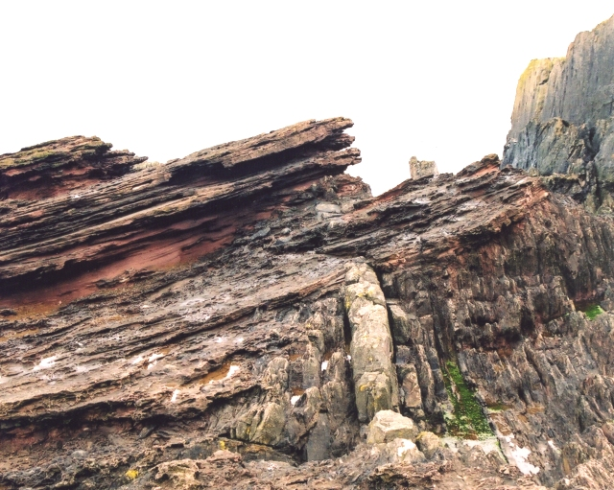
Evidence in Stone
In 18th and 19th centuries, scientists began to examine the Earth in great detail
Discovered Earth was very old, changed slowly over a long period of time by natural forces like weather
Influenced Darwin’s thoughts

Slide 16
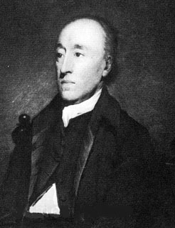
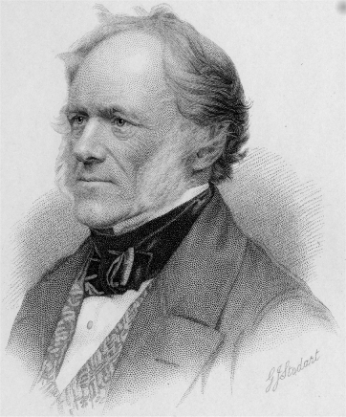
Evidence in Stone
James Hutton
1788, proposed rocks, mountains, and valleys had been changed gradually by rain, heat, cold, volcanic activity, and other natural forces
Because these events occur slowly, he argued that Earth had to more than a few thousand years old
1830, Charles Lyell agreed that Earth had changed slowly and gradually over time
Further evidence suggested that the land is constantly moving and shifting

Slide 17
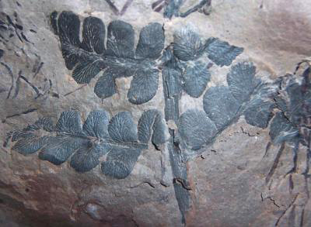
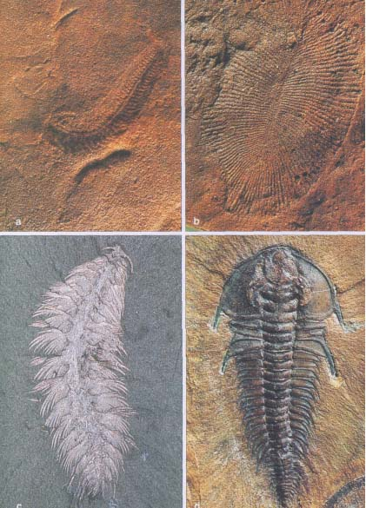
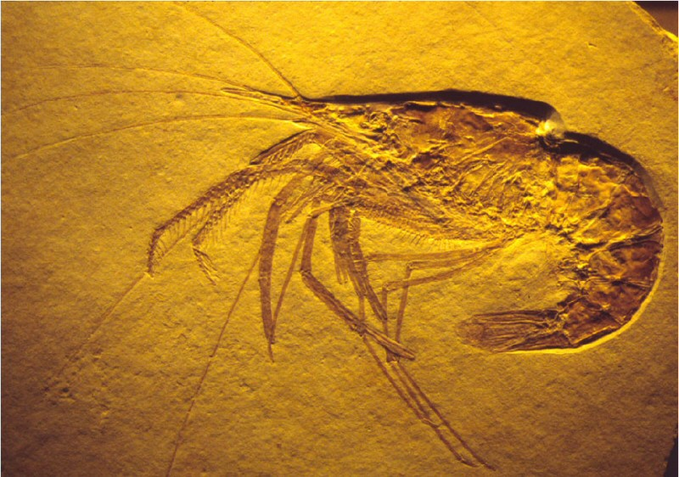
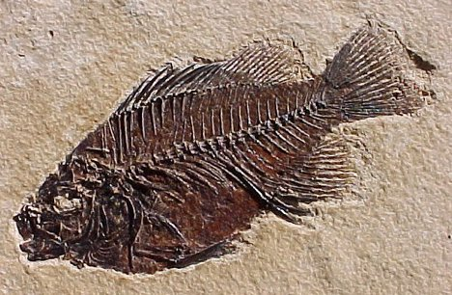
Evidence in Stone
Other scientists found evidence that life on Earth had changed over time
Discovered fossils in stones
Fossils= preserved remains of ancient organisms

Slide 18
The Geologic Time Scale: A clock in the Rocks
Biologists and geologists date the Earth’s past with the help of a record in the rocks called the geologic time scale
More than 100 years ago, researchers noticed that certain layers of rock often appeared in the same vertical order wherever they were found
It is the position of the layers relative to each other that determines their age
Helped geologists assemble a column of rocks in which each layer represented a different period of time

Slide 19
The Geologic Time Scale: A clock in the Rocks
Relative dating= a technique used by scientists to determine the age of fossils relative to other fossils in different layers of rock
Not ACTUAL because scientists did not know how long it took for the layers to form

Slide 21
Radioactive Dating
Near the middle of this century, our growing understanding or radioactivity provided scientists with a tool that could help determine the ACTUAL age of rocks
Rocks are made up of elements, some are radioactive
Radioactive elements decay, or break down, into nonradioactive elements at a very steady rate
Rate of decay is measured in the unit of half-life
Half-life= the length of time required for half the radioactive atoms in a sample to decay

Slide 22
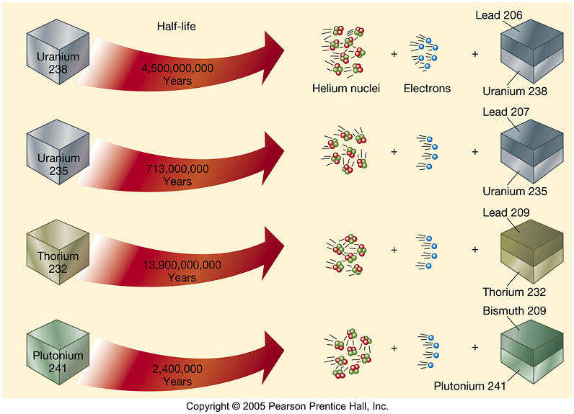

Slide 23
Radioactive Dating
Each radioactive element has a different half-life
Carbon-14 is particularly useful because it can be used to date material that was once alive, such as bones, or to date objects that contain once-living material
Because carbon-14 is in the atmosphere, living things take it into their bodies while they are alive
After an organism dies, it no longer takes in carbon-14

Slide 24
Radioactive Dating
The traces of radioactive isotopes enable scientists to calculate the actual age of a sample = radioactive dating
Earth is about 4.5 billion years old
Scientists have divided the 4.5 billion years into large units called eras→periods→epochs
Do not have standard lengths

Slide 25
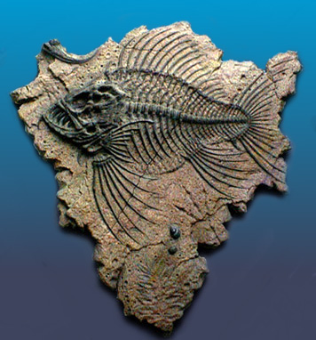
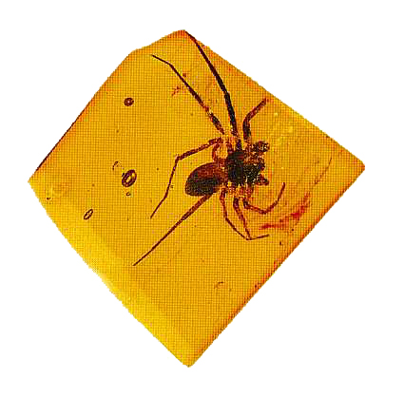
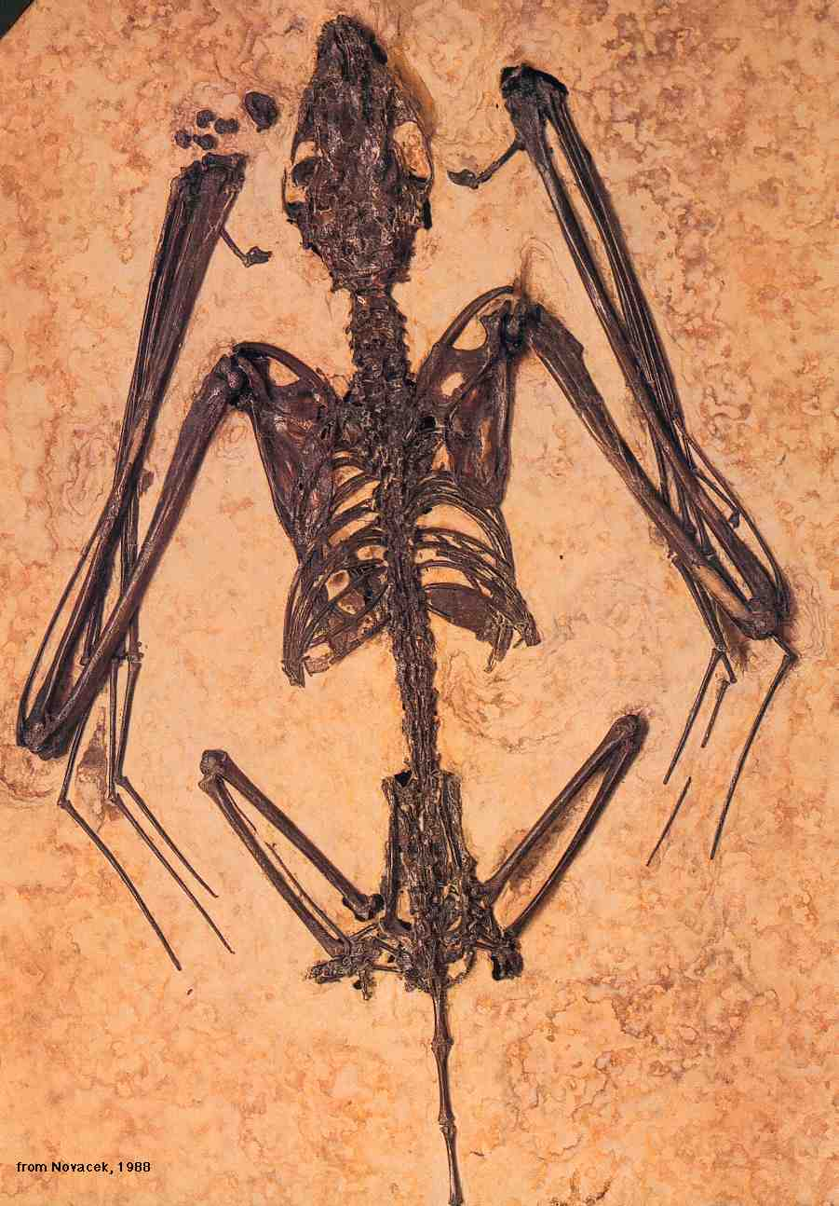
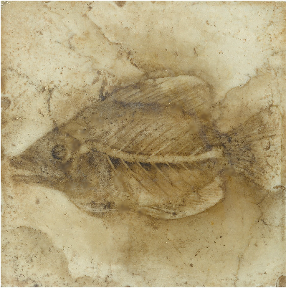
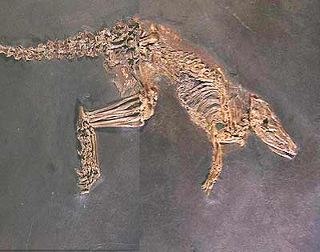
The Fossil Record
How Fossils Form
Fossil Evidence: Problems in Assembling the Puzzle
What the Fossil Record Tells Us

Slide 26
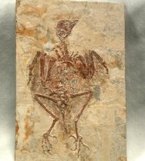
Biologists have learned about animals and plants that lived long ago by examining preserved traces of those organisms, or fossils
Many different types of fossils
Large and complete
Small and incomplete
Most fossils Darwin found were so strange that they resemble creatures from science fiction films

Slide 27
How do these organisms leave their remains in stone?
How do fossil remains help to explain the history of life on Earth?

Slide 29
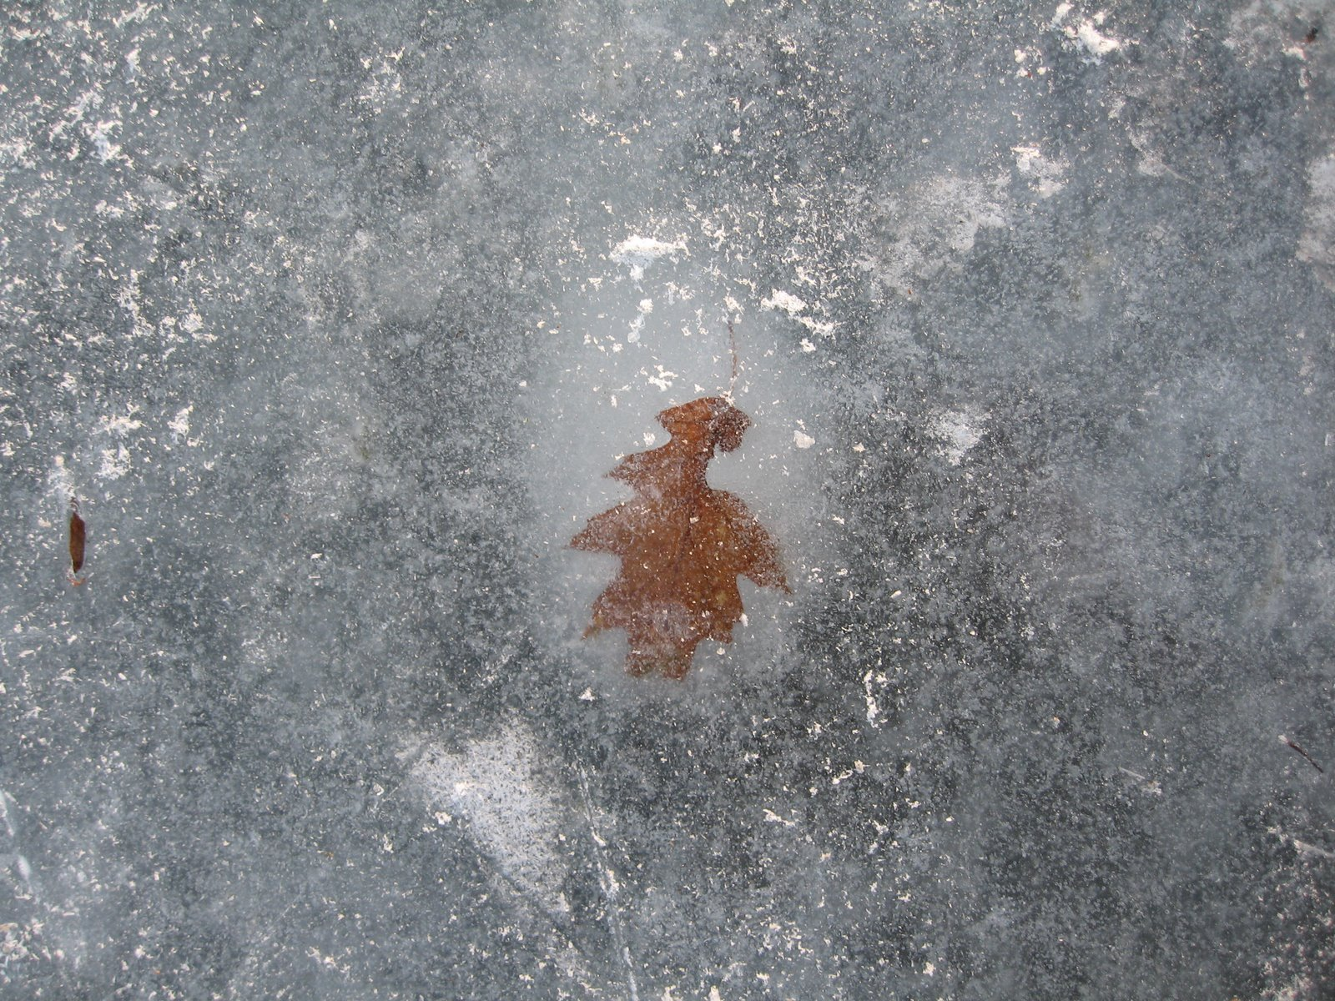
How Fossils Form
Depend a great deal on chance
In cold places
fell into crevasses in ice or became trapped in snow
Insects and other animals
trapped in the sticky tree sap (amber)
animals became trapped in peat bogs, quicksand, or tar pits
Helped protect from decay and preserved it

Slide 30
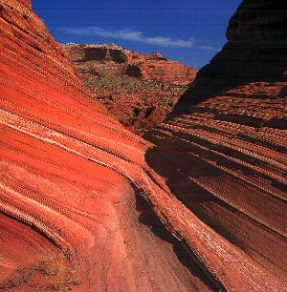
How Fossils Form
Most fossils found in sedimentary rock
Sedimentary rock-formed when exposure to rain, heat, and cold breaks down existing rocks into small particles of sand, silt, and clay
Particles carried by streams and rivers into lakes or seas
Heavier than water→sink to bottom
Build up
Pressure compresses the sediments and slowly turns them into rock
Preserves remains of dead organisms

Slide 31
Fossil Evidence: Problems in Assembling the Puzzle
Fossil record is not as complete as we would like it to be
Many organisms die without leaving a trace
Finding fossils is difficult if not impossible
Fossils may be exposed by weather
Grand Canyon
Quality of fossil preservation varies
Some so perfectly that we can see the microscopic structure of tiny bones and feathers
Some not preserved well
Reconstruct from pieces
To accurately date a fossil, scientists look for a sample of rock from the same geological layer and test its age by radioactive dating

Slide 32
What the Fossil Record Tells Us
paleontologist=scientist that studies fossils
Have collected millions of fossils
Fossil record
Represents the preserved collective history of Earth’s organisms
Shows the probable relationships between ancient animals whose evolutionary line gave rise to modern animals
Tells of major changes that occurred in Earth’s climate and geography
Shark tooth in AZ
Giant fern in Canada
Change followed change on Earth

Slide 33
Evidence from Living Organisms
Similarities in Early Development
Similarities in Body Structure
Similarities in Chemical Compounds
What Homologies Tell Us

Slide 34
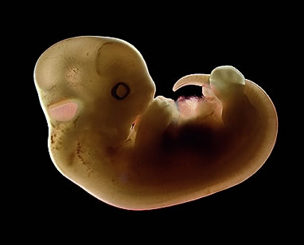
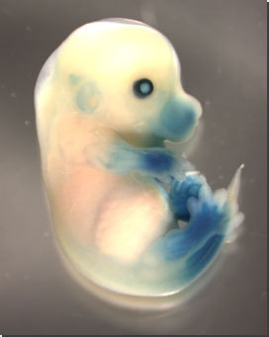
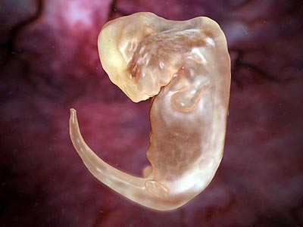
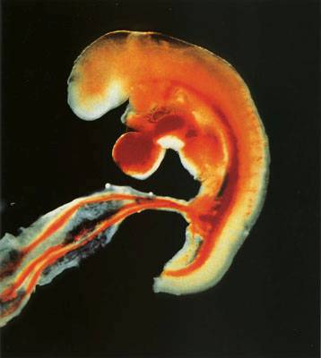
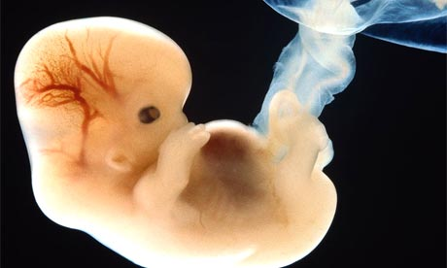
Similarities in Early Development
Late 19th century, scientists noticed that the embryos of many different animals were very similar
Embryos=organisms at early stages of development
What do these similarities mean?

Slide 35
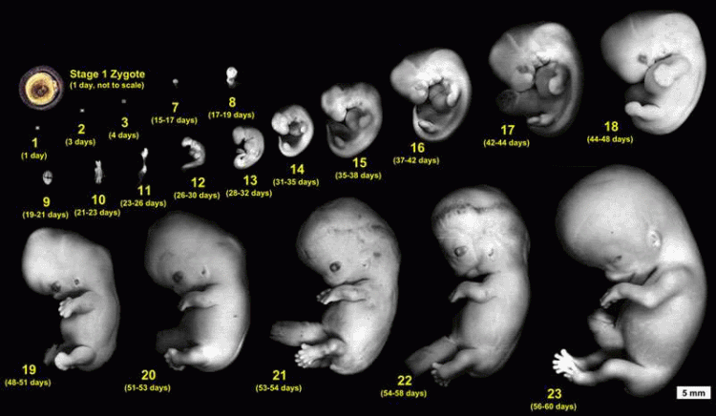
Similarities in Early Development
Similarities of vertebrate embryos show that similar genes are at work
All share the same basic control mechanism

Slide 36
Similarities in Early Development
The common ancestors of these animals passed on a single genetic pattern of development to their descendants
Mutations
Good or bad?

Slide 37
Similarities in Early Development
Evolution acted on mutations
Over time, these changes produced new animals whose adult bodies were as different from each other as fishes and horses are
Lethal was eliminated by natural selection
Successful were likely retained
Genes that control the earliest stages of development remain unchanged
Embryos of different species resemble each other
Evidence for evolution

Slide 38
Similarities in Body Structure
Embryos look very similar
As they mature, limbs grow into arms, wings, legs, and flippers that differ greatly in form and function
Evolve in a series of evolutionary changes that changed the structure and appearance of ancient animals
Based on same pattern of bones
Adapted in a different way
Help organism survive in environment
Homologous structures=same needs but develop from the same body parts

Slide 39
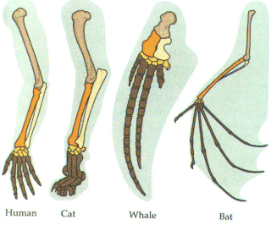

Slide 40
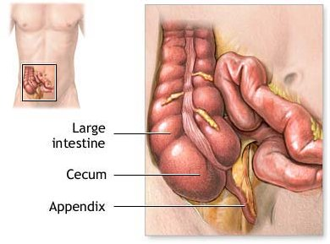
Similarities in Body Structure
Some animals have organs that are so reduced in size or function that they are merely traces (vestiges) of similar organs in other species
Vestigial organs
Resemble mini legs, tails, etc…
Why have an organ that has little or no function?

Slide 41
Similarities in Body Structure
Evolutionary change
Develop new adaptations
Some organs lose their use/need
Organs may be eliminated or reduced in size
Only a remnant of what was once important
Clue to the animal’s evolutionary ancestry

Slide 42
Similarities in Body Structure
Snake
Evolved from 4 legged ancestors
Some pythons and boas have tiny bones that are remnant of legs
Human
Mini tailbones at base of spine
Muscles that move ears
appendix

Slide 43
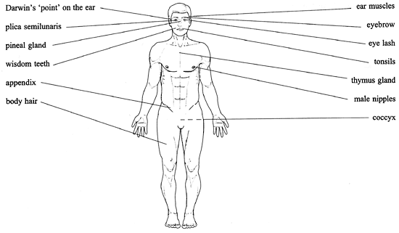

Slide 44
Similarities in Chemical Compounds
All organisms share many chemical details
Use DNA and/or RNA to carry info from one generation to the next and to control growth and development
DNA
Same basic structure and replication
ATP
Energy carrier found in all living systems

Slide 45
What Homologies Tell Us
The structural and biochemical similarities among living organisms are best explained by Darwin’s conclusion:
Living organism evolved through gradual modification of earlier forms
Descent from a common ancestor
If organisms had arisen independently of one another, there would be very little chance that they would have similar structures and biochemistries

Slide 46
