Slide 1
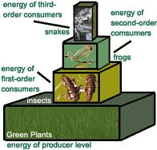
Energy Pyramid
shows the total amount of incoming energy at each successive level
energy (heat) lost going from one trophic level to another

Slide 2
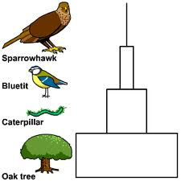
Pyramid of Biomass
shows the total mass of living tissue at each level

Slide 3
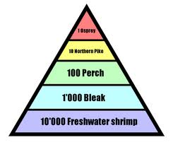
Pyramid of Numbers
illustrates the total number of organisms at each level
show only the amount of organic material present at one time

Slide 4
Biogeochemical Cycles
energy moves in a one-way direction
nutrients are recycled
all organisms require certain essential nutrients in order to grow

Slide 5
Biogeochemical Cycles
Nutrients move through the biosphere in a series of physical and biological processes
biogeochemical cycles
may be used over and over again by living systems

Slide 6
Water Cycle
movement of water from the atmosphere to the Earth and back to the atmosphere
alternation of evaporation and condensation
groundwater
water that sinks into the ground
upper surface is known as the water table

Slide 7
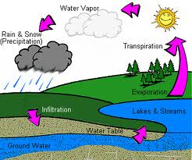

Slide 8
Nitrogen Cycle
Movement of nitrogen through the biosphere
All organisms require nitrogen to build proteins
available in several ways

Slide 10
Nitrogen Cycle
Free nitrogen gas makes up 78% of the atmosphere
wastes produced in dead and decaying organisms

Slide 11
Nitrogen Cycle
most nitrogen gas cannot be directly used by living things
must be converted into other forms

Slide 12
Nitrogen Cycle
nitrogen fixation
change free nitrogen in the atmosphere into nitrogen compounds
nitrates, nitrites
certain bacteria
nitrifying bacteria

Slide 13
Nitrogen Cycle
denitrification
bacteria in soil break down nitrogen compounds
denitrifying bacteria

Slide 14
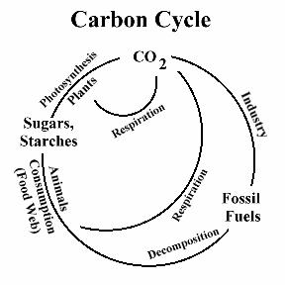
The Carbon and Oxygen Cycles
Carbon cycle
carbon is moved through the environment
during photosynthesis

Slide 15
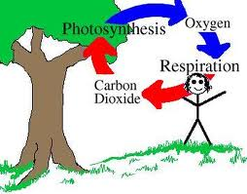
The Carbon and Oxygen Cycles
Oxygen cycle
movement of oxygen through the environment
during photosynthesis

Slide 16
Nutrient Limitation
rate at which producers can capture energy and use it to produce living tissue is controlled by several factors
limiting factor
amount of nutrients available
limit an organism’s growth

Slide 17
Nutrient Limitation
adding nutrients does not always hurt an ecosystem
extra fertilizer may help the system produce more plants and animals for human food
must be careful tampering with ecosystems

Slide 18
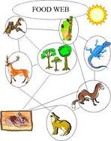
Feeding Relationships
animals and plants are tied together
networks of feeding relationships
food chain

Slide 19
Food Web
plants absorb nutrients and grow
herbivores eat plants
carnivores eat herbivores and each other
scavengers eat dead animals
bacteria and fungi decompose dead tissue, returning essential elements to the environment
filter feeders strain floating organisms from water
detritus feeders eat bacteria and wastes of other organisms
parasites live at the expense of host organisms

Slide 20
Feeding Relationships
food webs have built-in checks and balances
regulate the number of individuals of each species in the food web
many natural ecosystems are remarkably stable

