Slide 1
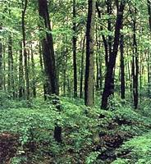
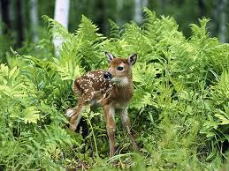
Temperate Deciduous Forests
Eastern coast of US, Southern coast of Canada, most of Europe, parts of Japan, China and Australia
changing seasons and leaf fall
oak, maple, beech, birch trees
deciduous-shed leaves in autumn

Slide 2
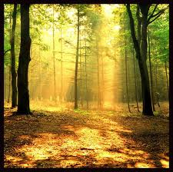
Temperate Deciduous Forests
rainfall sufficient year round
cold winters halt plant growth for several months

Slide 3
Temperate Deciduous Forests
animals hunted near extinction
protection and hunting regulations
deer, moose, gray foxes

Slide 4
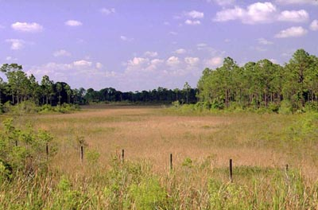
Grasslands
North America, steppes of Russia, veld of South Africa, pampas of Argentina
interior portions of many continents
covered with grasses and small leafy plants
significant rainfall
hot summers and cold winters

Slide 5
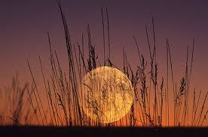
Grasslands
interactions among animals and plants shape the environment
stable
do not undergo ecological succession
wheat, corn, other grains heavily farmed

Slide 6
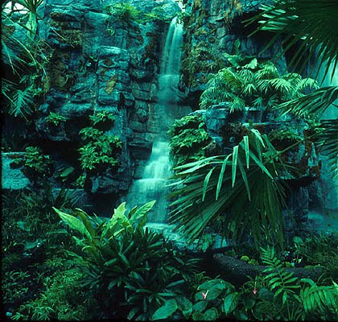
Tropical Rain Forests
warms temperatures and rain fall year round
200-400 cm
25 degrees C
South America, Southeast Asia, Africa, Central America

Slide 7
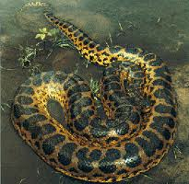
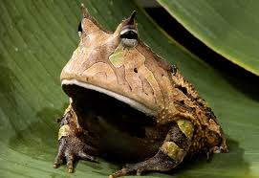
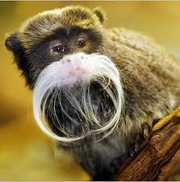
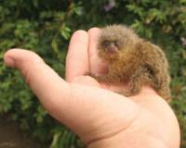
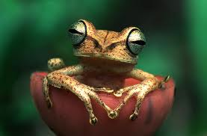
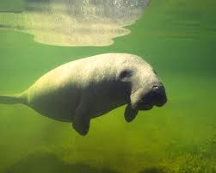
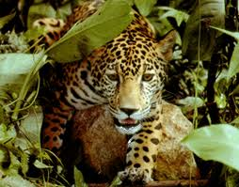
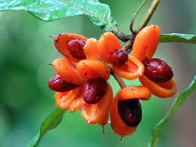
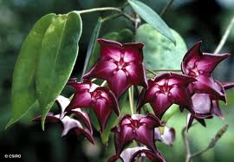
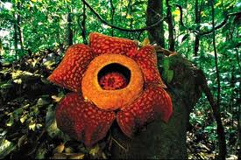
Tropical Rain Forests
home to more species of plants and animals than can be found in all the rest of the land biomes combined!!

Slide 8
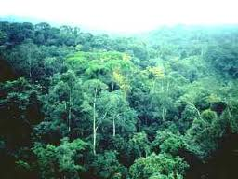
Tropical Rain Forests
Trees grow up to 70 m
canopy
tree dwellers

Slide 9
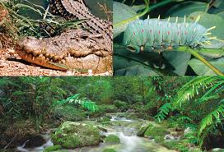
Tropical Rain Forests
animal life is rich and varied
colorful insects and birds
reptiles, small mammals, amphibians

Slide 10
Tropical Rain Forests
many animals and plants produce chemicals that may be useful in fighting some types of diseases

Slide 11
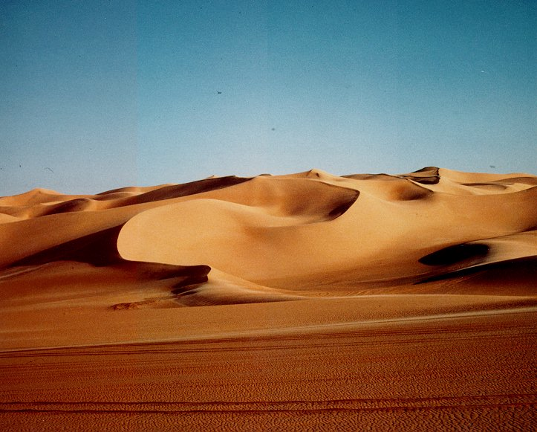
Deserts
less than 25 cm of rainfall annually
Sahara in Africa
world’s largest desert
rain almost NEVER falls
wind hot and dry
almost nothing grows
lizards, insects, scorpions, snakes, birds

Slide 12
Deserts
Seasonal Deserts
some rainfall
Cold Deserts
brief rainy season
permits growth of grasses and shrubs
soil is often very fertile

Slide 13
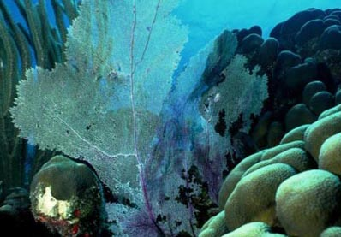
Aquatic Biomes
Water ecosystems
freshwater, marine, estuaries
Abiotic factors that affect organisms found in the aquatic biomes
light intensity
amounts of O2 and CO2 dissolved in water
availability of organic and inorganic nutrients

Slide 14
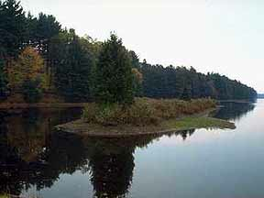
Freshwater Biomes
Rivers, streams, lakes
drinking water, food
tiny plants and animal swim / drift through water
eaten by fishes and amphibians
eat vegetation and insects that fall into the water

Slide 15
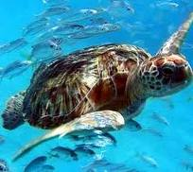
Marine Biomes
ocean
covers most of the surface of the Earth
photosynthesis takes place in upper region
photic zone
30m to 200m
phytoplankton and algae

Slide 16
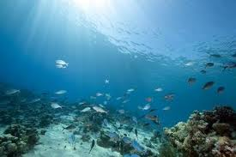
Marine Biomes
Intertidal zone
Neritic zone
Open-sea zone
Deep-sea zone

Slide 17
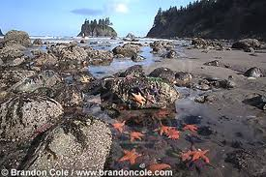
Intertidal Zone
most difficult zone for organisms to live in
radical changes in their surroundings
clams, barnacles, seaweed, sea urchins, snails, starfish

Slide 18
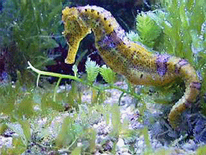
Neritic Zone
extends from low-tide line to the edge of the open sea
large algae (seaweed) abundant
photic zone
giant kelp
meadows of turtle grass

Slide 19
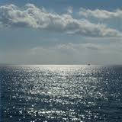
Open-Sea Zone
phytoplankton are responsible for 80-90% of Earth’s photosynthetic activity
eaten by larger animals

Slide 20
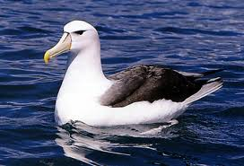
Open-Sea Zone
dolphins, whales, sea birds (albatrosses)
nutrients scarce
phytoplankton relatively low
limits the number of animals

