Slide 1
Protein Synthesis
12-08-08

Slide 2
Protein Synthesis
The info that DNA transfers to mRNA is in the form of a code
The code is determined by the way in which the four nitrogenous bases are arranged in DNA

Slide 3
Protein Synthesis
The nitrogenous bases in DNA contain info that directs protein synthesis
Most enzymes are proteins
Proteins : control biochemical pathways in the cell, direct synthesis of lipids, proteins, cho’s, and nucleotides, responsible for cell structure and cell mvmt
DNA and RNA are directly responsible for making proteins

Slide 4
The Nature of the Genetic Code
Proteins are made by stringing long chains of aa’s together to form long chains called polypeptides
Each polypeptide contains a combination of any or all the 20 different aa’s
Because DNA and RNA have different nitrogenous bases, the genetic code must have a four-letter ‘alphabet’

Slide 5
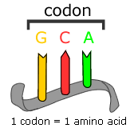
The Nature of the Genetic Code
The code words of the DNA nucleotides are copied onto a strand of mRNA
Each combo of 3 nucleotides on the mRNA is called a codon
Codon = each codon specifies a particular aa that is to be placed in the polypeptide chain
There is more than one codon for each aa

Slide 6
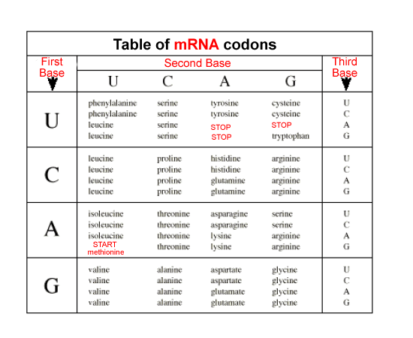

Slide 7
Genetic Code
Genetic code consists of 64 codons along with their corresponding aa’s
These codons are found on the mRNA

Slide 8
Translation
Translation = The decoding of a mRNA message into a polypeptide chain (protein)
The message is being translated from the language of nucleic acids into a polypeptide
The mRNA does not produce a polypeptide by itself
Translation involves the two other main types of RNA
Transfer RNA (tRNA)
Ribosomal (rRNA)

Slide 9
Translation
tRNA carried aa’s to the ribosomes, where the aa’s are joined together to form polypeptides
tRNA is a single strand of RNA that loops back on itself
there are different tRNA molecules for each of the 20 aa’s

Slide 10
role of tRNA
in order to translate info from a single codon of mRNA, such as AUG, we would have to find out which aa is coded for by AUG
AUG = methionine
Methionine is then brought to the polypeptide chain by tRNA

Slide 11
role of tRNA
The nucleotides will base pair with a codon on mRNA
Because the three nucleotides in tRNA are complementary to the three nucleotides on mRNA, the three tRNA nucleotides are called the anticodon

Slide 12
Role or rRNA
Ribosomes are made up of two subunits, a large one and a smaller one
Each subunit consists of rRNA and proteins
The first part of protein synthesis occurs when the two subunits of the ribosome bind to a molecule of mRNA

Slide 13
Role of rRNA
The initiator codon AUG then binds to the first anticodon or tRNA signaling the beginning of a polypeptide chain
Soon the anticodon of another tRNA binds to the next mRNA codon
The second tRNA carries the second aa that will be placed into the chain of the polypeptide

Slide 14
Role of rRNA
As each anticodon and codon bind together, a peptide bond forms between the two aa’s
A polypeptide bond is the covalent bond that joins two aa’s together

Slide 15
Role of rRNA
The polypeptide chain continues to grow until the ribosome reaches a stop codon on the mRNA
When the stop codon reaches the ribosomes, the ribosome releases the newly formed polypeptide and mRNA, completing the process of translation

Slide 16
Review
DNA directs the synthesis of three different kinds of RNA
tRNA
rRNA
mRNA
each kind of RNA helps to make the genetic code work

