Slide 1
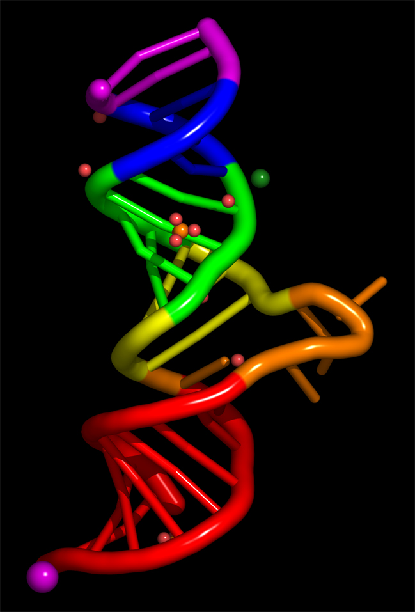
RNA
10-09-08

Slide 2
RNA
The double helix explains how DNA can be replicated / copied but does not explain how info is contained in the molecule or how that info is put to use
The first step in decoding the DNA message is to copy part of the sequence into RNA
RNA = the nucleic acid that acts as a messenger between DNA and the ribosomes and carries out the process by which proteins are made from amino acids

Slide 3
Structure of RNA
Consists of a long chain of macromolecules made up of nucleotides
Each nucleotide is made up of a 5-carbon sugar, a phosphate group, and a nitrogenous base
The alternating sugars and phosphate groups form the backbone of the RNA chain
Very similar to RNA

Slide 4
3 Differences between RNA and DNA
The sugar in RNA is ribose, the sugar in DNA is deoxyribose
RNA consists of a single strand of nucleotides, DNA is double-stranded
The nitrogenous bases found in DNA are adenine, thymine, cytosine, and guanine, RNA contains uracil instead of thymine

Slide 5
Transcription: RNA synthesis
The molecule being copied is just one of the two strands of a DNA molecule
The molecule being synthesized is different from the molecule being copied
Transcription = the process by which a molecule of DNA is copied into a complementary strand of RNA (transferring info from DNA to RNA)

Slide 6
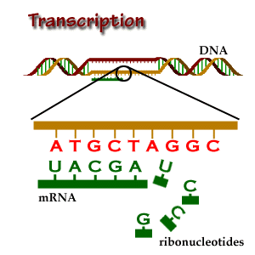

Slide 7
Why is it necessary for DNA to transfer its genetic info to RNA?
Remember DNA is found in the nucleus and ribosomes are located in the cytoplasm
Because DNA does not leave the nucleus, a messenger, or carrier, must bring the genetic information from the DNA in the nucleus out to the ribosomes in the cytoplasm
The molecule that performs this function is messenger RNA (mRNA)
mRNA is one of the 3 main types of RNA

Slide 8
RNA polymerase
Works on the polymers RNA and DNA
Attaches to special places on the DNA molecule, separates the two strands of the double helix, and synthesizes a mRNA strand
The mRNA strand is ‘complementary’ to one of the DNA strands
Special sequences in DNA serve as “start signals” and are recognized by RNA polymerase and other proteins associated with transcription
Other areas on the DNA molecule are recognized as termination sites where RNA polymerase releases the newly synthesized mRNA molecules.

Slide 9
