Slide 1
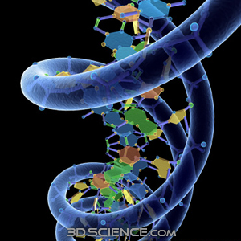
DNA
12-01-08

Slide 2
DNA
Cells are pre-instructed by a code, or programmed, about what to do and how to do it
A program, or code, in living cells must be able to duplicate itself quickly and accurately

Slide 3
The Genetic Code
Program of the cell=genetic code
Genetic code→anything that relates to heredity, the way in which cells store the program that they seem to pass from one generation to the next

Slide 4
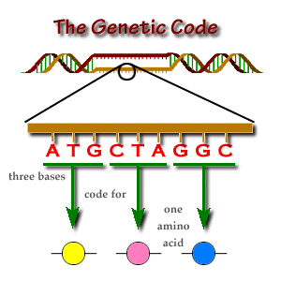

Slide 5
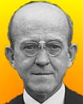
Frederick Griffith
In 1928, British scientist Frederick Griffith was studying the way in which certain types of bacteria cause the disease pneumonia in lab rats
Accidently discovered transformation
Transformation=process by which genetic material absorbed from the environment is added to or replaces part of a bacterium’s DNA

Slide 6
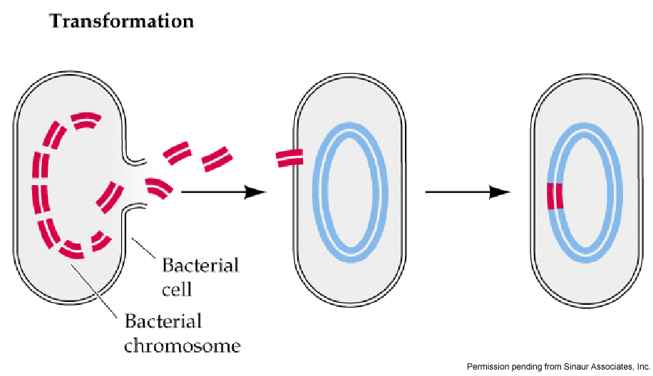
Transformation

Slide 7
Avery, et al.
In 1944, Avery, et al. discovered DNA was the transforming factor
DNA is the nucleic acid that stores and transmits the genetic info from one generation of an organism to the next (DNA carries the genetic code)

Slide 8
Hershey & Chase
In 1952, Hershey and Chase were interested in the kinds of viruses that infect bacteria (bacteriophages=bacteria eaters)
Bacteriophages are composed of a DNA core and a protein coat
They attach themselves to the surface of a bacterium and then inject a material into the bacterium
Once inside, the material soon begins to reproduce, making many copies of the bacteriophage
Soon the bacterium bursts, and several hundred bacteriophages are released to infect other cells which contain the genetic code

Slide 9
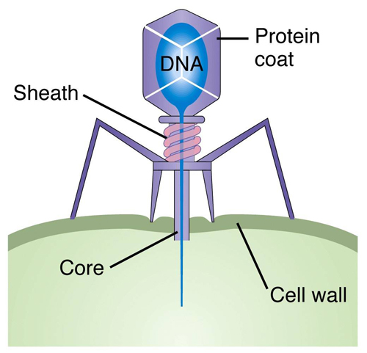
Bacteriophage

Slide 10
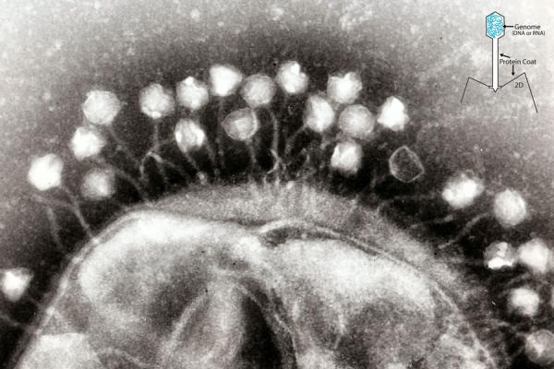
Bacteriophage

Slide 11
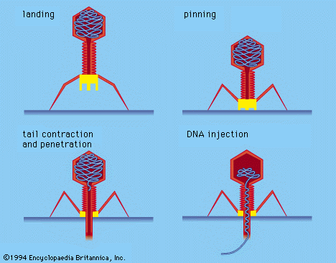
Hershey & Chase
Hershey and Chase wanted to know which part, the protein coat or the DNA, entered the bacterium
The viruses’ DNA enters the bacteria and the protein coat remains outside the bacteria

Slide 12
Structure of DNA
DNA is a polymer formed from units called nucleotides
Each nucleotide is a molecule made up of three basic parts: a 5-carbon sugar (deoxyribose), a phosphate group, and nitrogenous base.

Slide 13
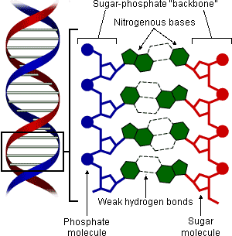

Slide 14
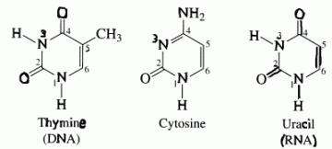
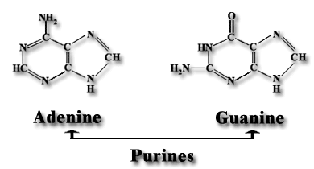
Structure of DNA
DNA contains 4 nitrogenous bases
Purines= adenine and guanine
Pyrimidines= cytosine and thymine

Slide 15
Structure of DNA
Individual nucleotides are joined together to form a long chain, sugars and phosphate groups form the backbone of the chain and the nitrogenous bases stick out from the chain

Slide 16
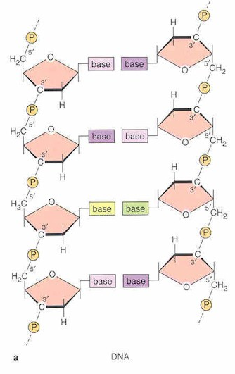

Slide 17
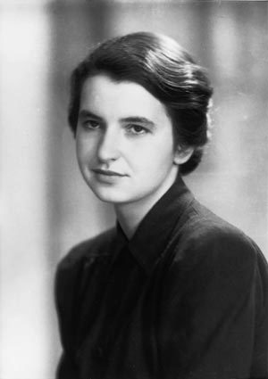
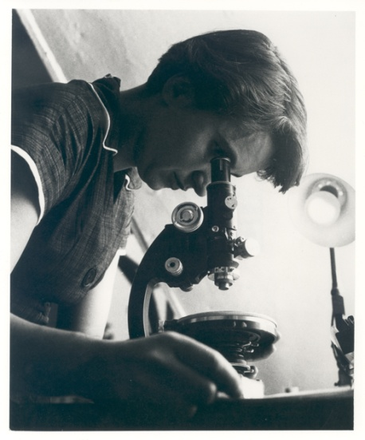
Rosalind Franklin
In early 1950’s Rosalind Franklin created x-ray patterns of DNA
Does not prove anything but does provide some very important clues about the structure of DNA
Fibers that make up DNA are twisted
Large groups of molecules in the fiber are spaced out at regular intervals along the length of the fiber

Slide 18
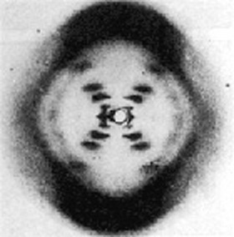
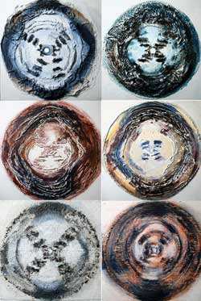
DNA X-ray

Slide 19
Watson & Crick
Francis Crick and James Watson had been trying to solve the mystery of DNA structure by building a 3-dimensional model
During a trip, Watson was able to observe Franklin’s x-ray pattern of DNA
Watson and Crick used the clues from the x-ray and within weeks had figured out the structure of DNA
W & C played with models trying to twist them into a shape that would account for Franklin’s x-ray pattern
Developed a shape that made sense-helix (similar to a spiral)

Slide 20
Watson & Crick
Using Franklin’s idea that there were probably two strands of DNA, W & C imagined that the strands were twisted around each other, forming a double helix
W & C’s model had nitrogenous bases on each of the strands of DNA, positioned exactly opposite of each other
Positioning allows weak hydrogen bonds to form btw the nitrogenous bases adenine (A) and thyamine (T), and btw cytosine (C) and guanine (G)

Slide 21
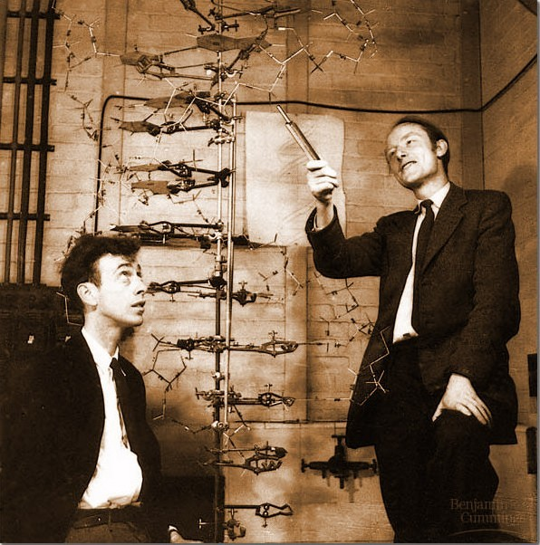

Slide 22
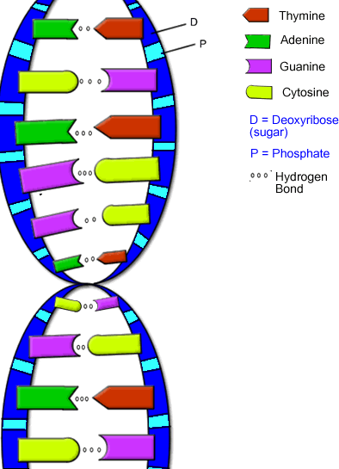

Slide 23
Watson & Crick
Erwin Chargaff observed that in any sample of DNA, # of adenine molecules=# of thymine molecules, # of cytosine molecules = # of guanine molecules
This enabled W & C to determine that A bond only to T and C to G.
The attraction between such bases is known as base pairing-the force that holds the two strands of the DNA double helix together

Slide 24
Watson & Crick
In 1953, W & C submitted their findings to a scientific journal. Their model was almost immediately accepted
Why? It contained a feature that explained how DNA could copy itself!

Slide 25
Watson & Crick
The importance of this work on DNA was acknowledged in 1962 by the awarding of the Nobel prize for medicine or physiology (the highest prize the international community can give for a scientific discovery)
B/c Rosalind Franklin had died in 1958 and Nobel prizes were given only to living scientists, the prize was shared by W & C and Franklin’s associate Maurice Watkins

