Slide 1
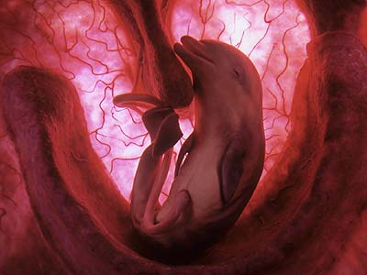
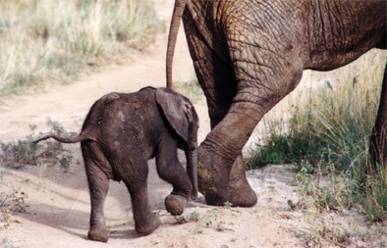
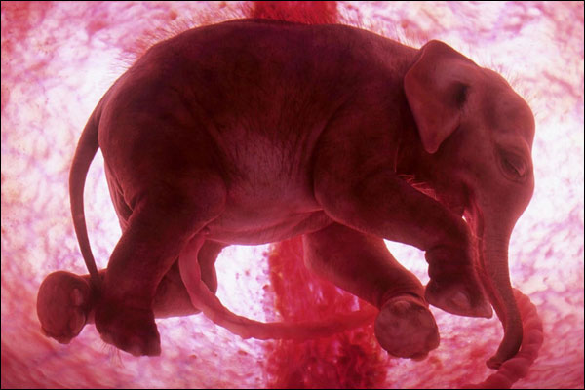
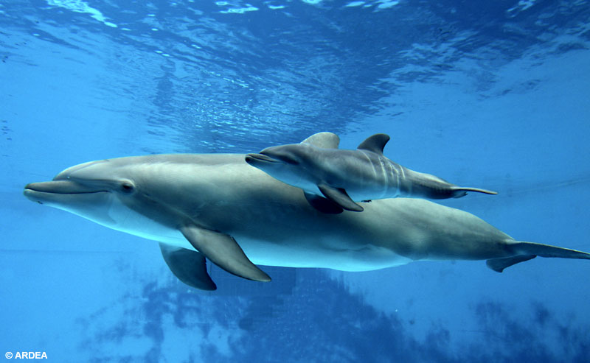
Characteristics of Living Things
09-08-08

Slide 2
Characteristics of Living Things
Are made up of one or more units called cells
Reproduce
Grow and develop
Obtain and use energy
Respond to their environment

Slide 3
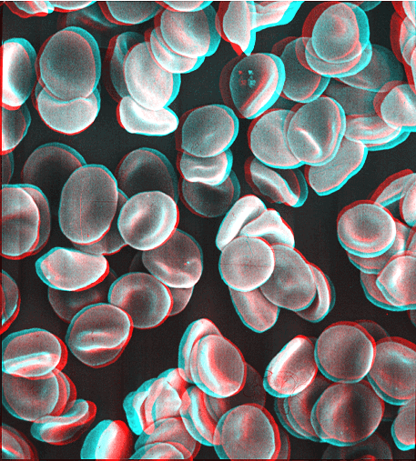
Living things are made up of cells
Living things are made up of small self-contained units called cells
Each cell is a collection of living matter enclosed by a barrier that separates the cell from its surrounding
Most cells can perform all the functions we associate with life

Slide 4
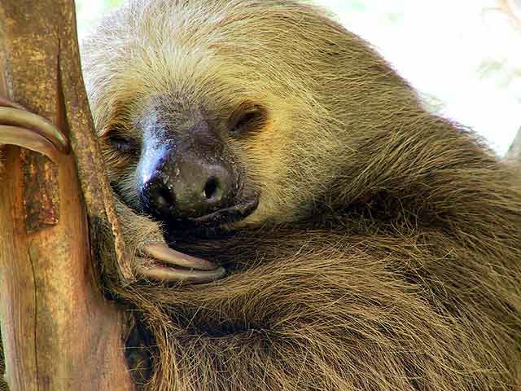
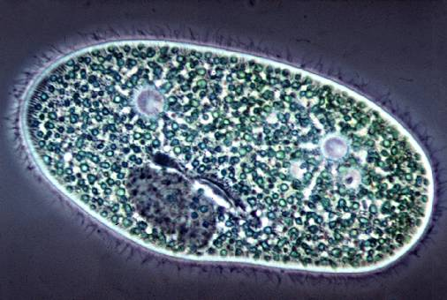
Living Things are made up of Cells
Cells are remarkably diverse
A single cell by itself can form an entire living organisms
Organisms consisting of only a single cell are called unicellular
Prefix uni- means one
Most of the organisms you are familiar with, such as dogs and trees, are multicellular
Prefix multi- means many
Multicellular organisms contain hundreds, thousands, even trillions of cells or more
Cells are NOT found in nonliving matter UNLESS that matter was once alive
Wood is made up largely of the walls that once separated the individual cells in the living tree

Slide 5
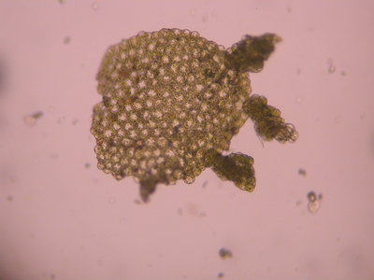
Living Things Reproduce
Living things can reproduce, or produce new organisms of the same type
Because all individual organisms eventually die, reproduction is necessary if a group of similar organisms is to survive

Slide 6
Two basic types of reproductions: sexual and asexual
Sexual reproduction requires that two cells from different individuals unite to produce the first cell of a new organism
Maple trees to birds and bees reproduce sexually
Asexual reproduction occurs when a single organism can reproduce without the aid of another
The prefix a- means without, so asexual means without sex
Can be very simple: some single-celled organisms merely divide in two to form two organisms

Slide 7
Living things grow and develop
All living things, at one stage or another in their lives, are capable of growth
An acorn, when it sprouts, produces roots, stems, a trunk, and leaves that continue to grow for years
As it grows, it takes in substances from the air and soil and transforms these substances into living tissue
Long after the tree stops getting larger, it continues to add new material to replace existing parts that wear out

Slide 8
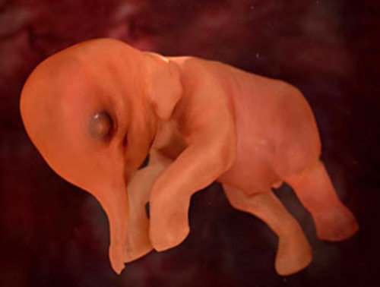
Living Things Grow and Develop
During growth, most living things go through a cycle of change called development
The single cell that starts an organism’s life divides and changes again and again to form the many and varied cells of an adult organism

Slide 9
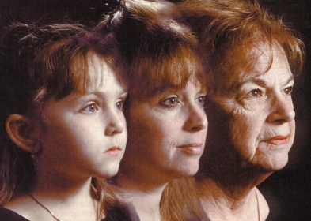
Living Things Grow and Develop
As development continues, organisms experience a process called aging
During aging, an organism becomes less efficient at the process of life
The ability to reproduce comes to an end
Death is the inevitable end of the life span of nearly all organisms
Death is also a process of change that separates living from non living things.

Slide 10
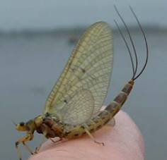
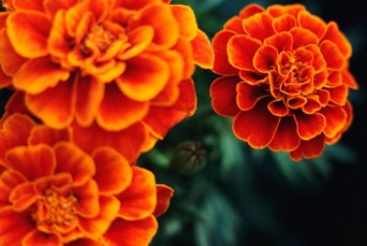
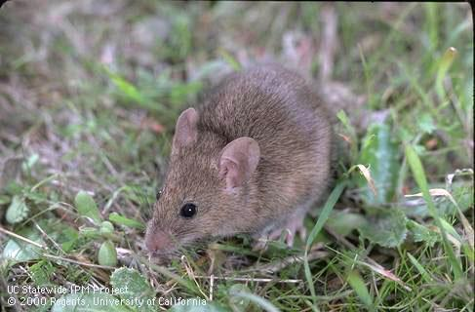
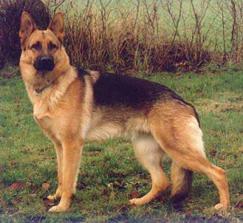
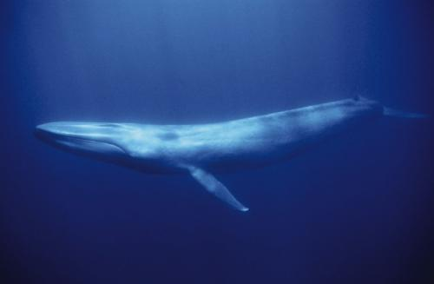
Maximum Life Spans
Organism | Life Span
Adult mayfly | 1 day
Marigold | 8 months
Mouse | 1-2 years
Dog | 17 years
Blue whale | 100 years
Tortoise | 152 years
Bristlecone pine | 5500 years

Slide 11
Living Things Obtain and Use Energy
Living things obtain and use energy from their environment, or their surroundings, and use that energy to grow, develop, and reproduce
All organisms require energy to build the substances that make up their cells
Any process in a living thing that involves putting together, or synthesizing, complex substances is called anabolism

Slide 12
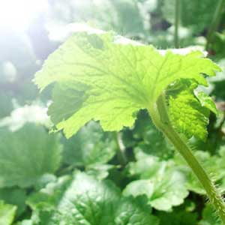
Living Things Obtain and Use Energy
Plants obtain their energy from sunlight in a process called photosynthesis
Prefix photo- means light, and suffix –synthesis means put together
Photosynthesis-put together with light

Slide 13
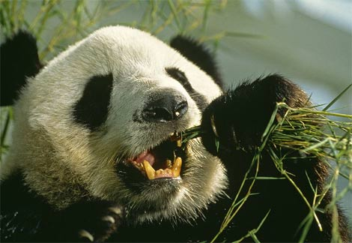
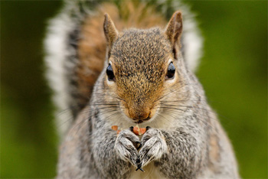
Living Things Obtain and Use Energy
Animals take in energy in the form of food
Food is broken down during a process called digestion
The final breakdown of complex substances into simpler ones, usually resulting in the release of energy, is called catabolism

Slide 14
Living Things Obtain and Use Energy
Living things must practice BOTH anabolism and catabolism at the same time
The total sum of all chemical reactions in the body-the balance of anabolism and catabolism- is called metabolism

Slide 15
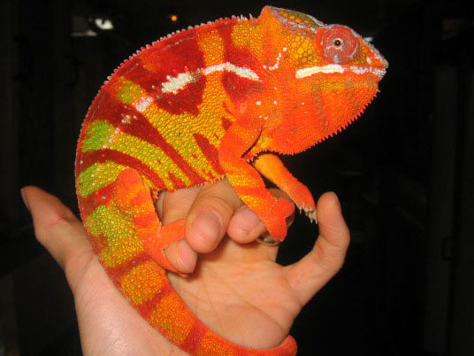
Living Things Respond to Their Environment
Responses can be rapid (usually changes in behavior) or slow (changes in metabolic processes or growth)
Anything in the environment that causes an organism to react is called a stimulus
Organisms react to many stimuli
Light, temperature, odor, sound, gravity, heat, water, and pressure

Slide 16
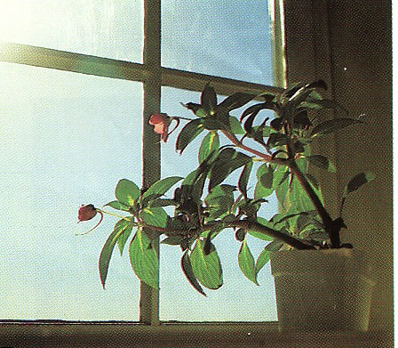
Living Things Respond to Their Environment
The ability of living things react to stimuli is known as irritability
Does not mean living things are grouchy
Both plants and animals exhibit irritability and can react to a variety of stimuli
Plants usually respond to stimuli slower than animals
Plants leaves and stems grow toward light and away from the pull of gravity
Plant roots respond to gravity by growing down into the soil

Slide 17
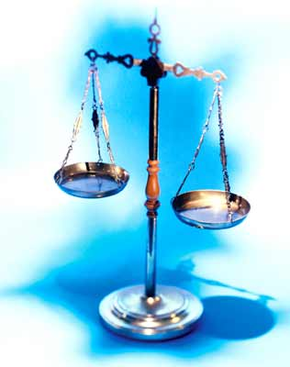
Living Things Respond to Their Environment
In general, living things respond to stimuli in ways that improve their chances for survival
The process by which organisms respond to stimuli in ways that keep conditions in their body suitable for life is called homeostasis
The prefix homeo- means similar or same
The suffix –stasis means standing or stopping
Homeostasis refers to an organism’s ability to maintain constant or stable conditions that are necessary for life

Slide 18
Board Work III On a separate sheet of paper, please answer the following in complete cursive sentences. Due at the end of class.
Describe five characteristics of living things
Compare sexual reproduction and asexual reproduction
Define metabolism, using the terms catabolism and anabolism in your definitions
Try to think of a nonliving thing that satisfies each characteristic of living things. Does any nonliving thing have all the characteristics of life?
How does a green plant obtain its energy?

