Slide 1
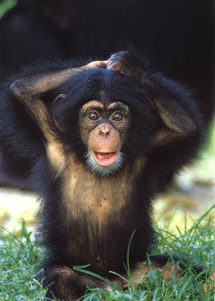
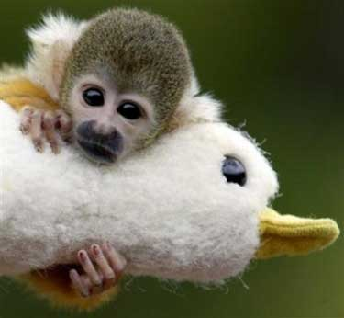
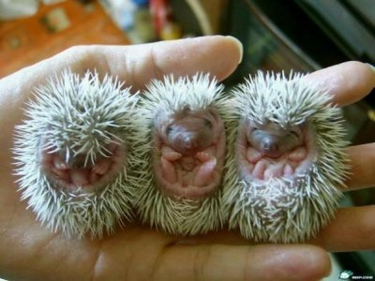
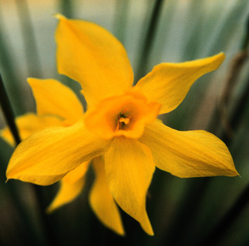
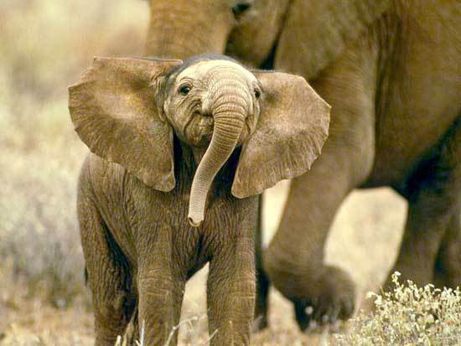
Classification Systems
Why Classify?
Biological Classification
Taxonomy Today
The Six-Kingdom System

Slide 2
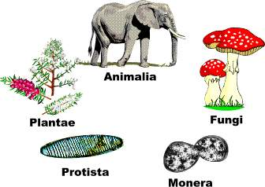
Why Classify?

Slide 3
To identify the need for a system of naming and organizing Earth’s organisms
To understand the great diversity of life
Need a system for naming and organizing Earth’s organisms
Over 2.5 million species
Useful to scientists all over the Earth
Universally accepted name to each organism
Universally accepted rules for grouping the organisms

Slide 4
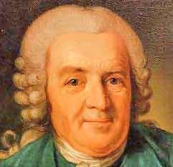
Biological Classification
The Naming System of Carolus Linnaeus
The Classification System of Linnaeus

Slide 5
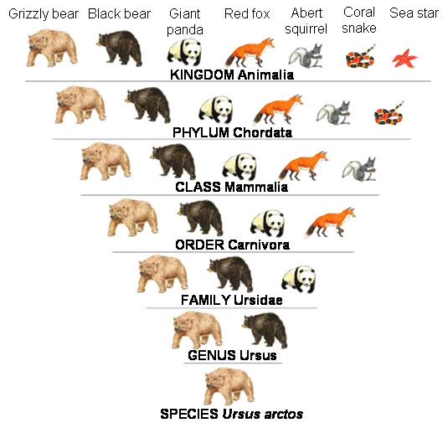

Slide 6
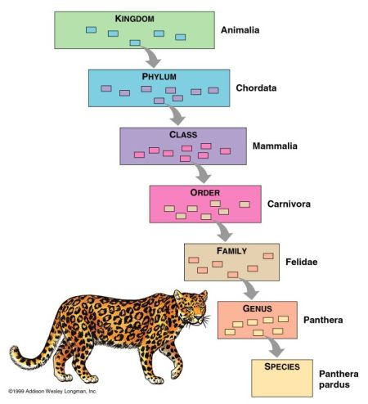
Key Terms
Binomial nomenclature
Taxonomy
Taxon
Species
Genus
Family
Order
Class
Phylum
kingdom

Slide 7
To identify the need for a universally accepted method of naming and grouping organisms
18th century, Linnaeus developed the system of binomial nomenclature
2 part scientific name to every organism
Genus and species name
Method of grouping organisms
Based on structural characteristics
Taxa
Kingdom, phylum, class, order, genus, species
Member of same taxa share certain similar traits

Slide 8
Taxonomy Today
Taxonomy and Evolutionary Relationships
Biochemical Taxonomy

Slide 9
To explain how taxonomy provides information regarding evolutionary relationships of organisms
Taxonomy=the science of naming organisms
Taxonomists
Identify and study homologous structures in organisims
Species shows to be closely related are classified together
grouped according to their evolutionary relationships
Biochemists classify organisms based on chemical compounds
DNA, RNA

Slide 10
Taxonomy and Evolutionary Relationships
Species shown to be closely related are classified together. Other species that may look alike but possess analogous structures only are classified in different groups.
Analogous structure=structures that are similar in appearance and function but have different origins and usually different internal structures

Slide 11
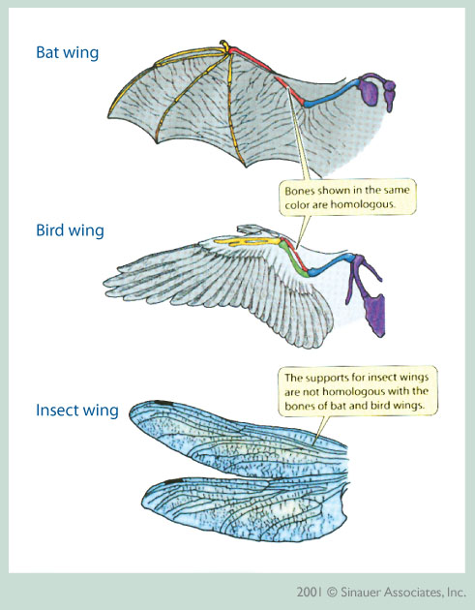

Slide 12
Biochemical Taxonomy
All forms of life share organic molecules that are almost identical from species to species
Genetic info
DNA
RNA
Cytochrome c

Slide 13
The Six-Kingdom System
The Prokaryotic Kingdoms
Protista
Fungi
Plantae
Animalia

Slide 14
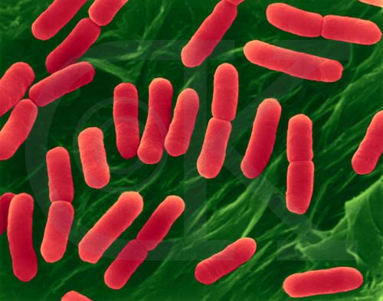
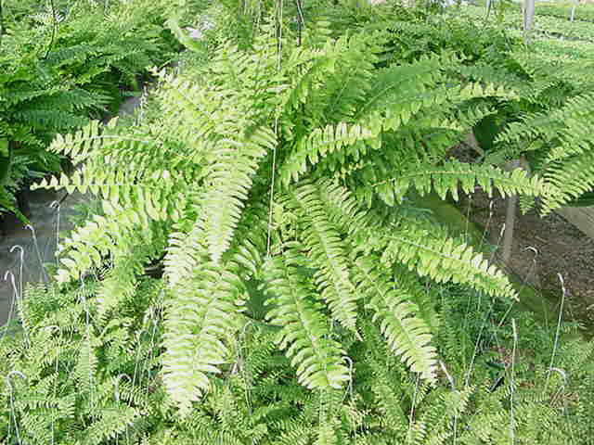
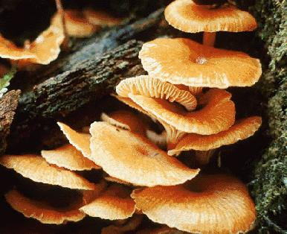
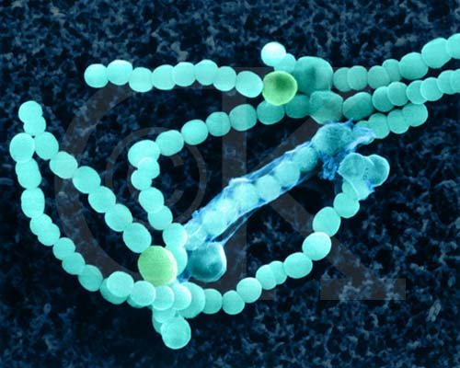
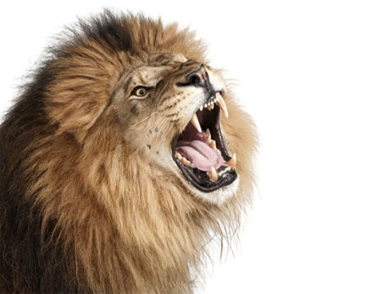
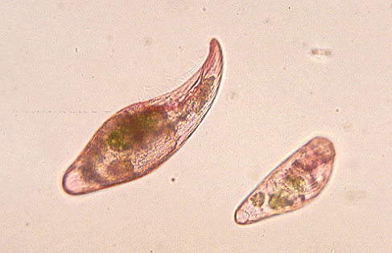
Key Terms
Eubacteria
Archaebacteria
Protista
Fungi
Plantae
Animalia

Slide 15
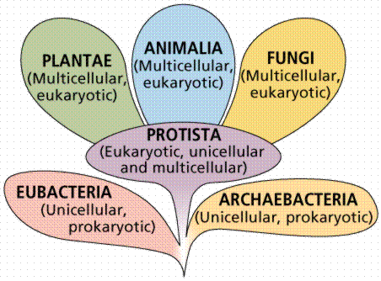

Slide 16
To identify the structure of the six-kingdom system of classification
Eubacteria
Archaebacteria
Protista
Fungi
Plantae
animalia

Slide 17
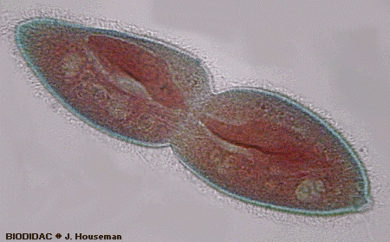
Prokaryotic kingdom
Eubacteria & Archaebacteria
First life forms on earth
Lack nuclei, mitochondria, chloroplasts
Binary fission

Slide 18
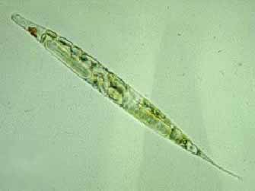
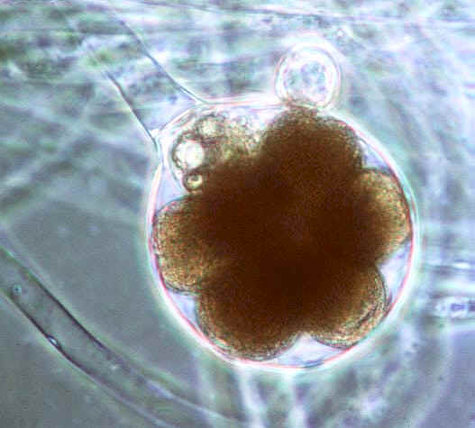
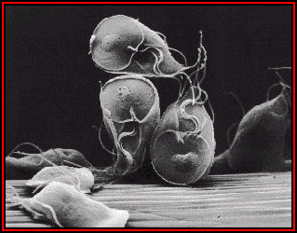
Kingdom Protista
Single-celled eukaryotes
Animallike
Plantlike
funguslike

Slide 19
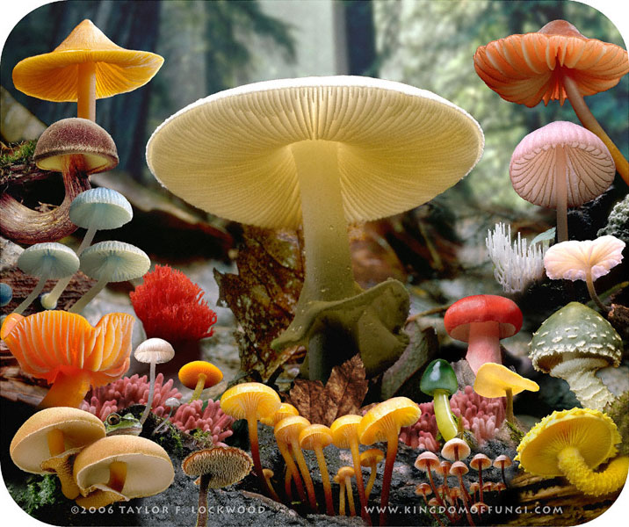
Kingdom Fungi
Cell walls do not contain cellulose
Heterotrophic
No photosynthesis
Single cell?

Slide 20
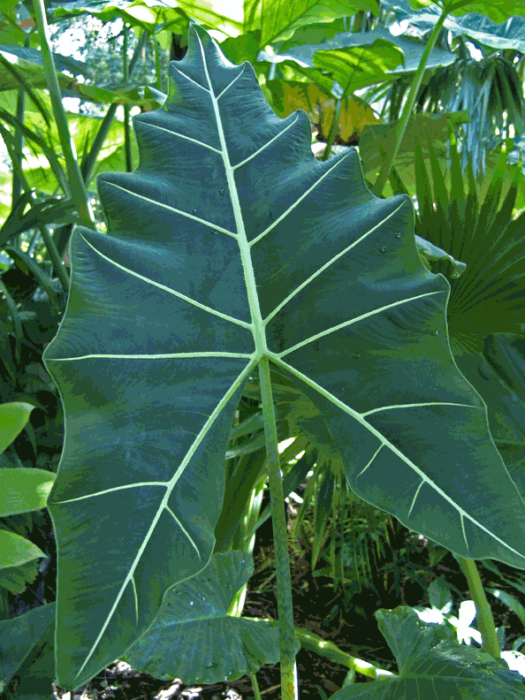
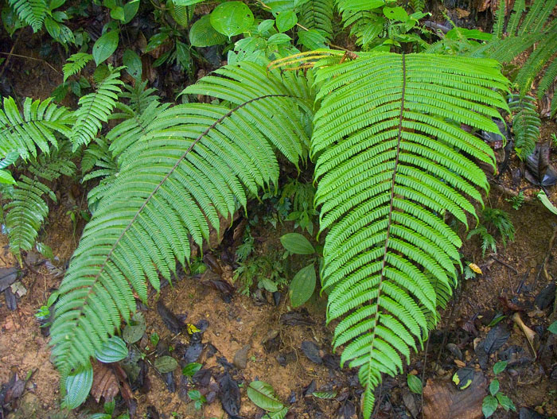
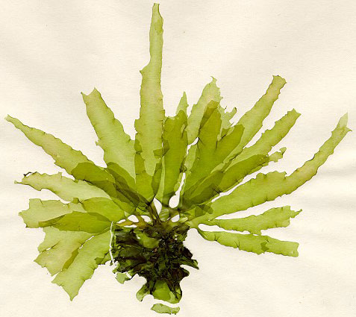
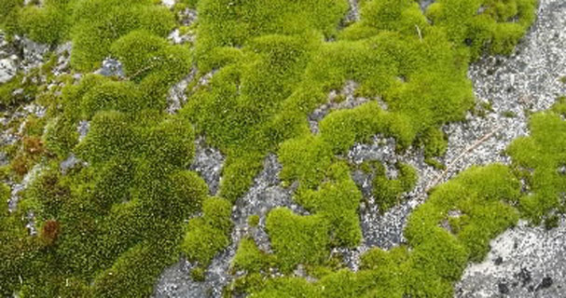
Kingdom Plantae
Multicellular
Cell walls contain cellulose
Autotrophic
Photosynthesis
Flowering plants
Mosses
Ferns
Multicellular algae

Slide 21
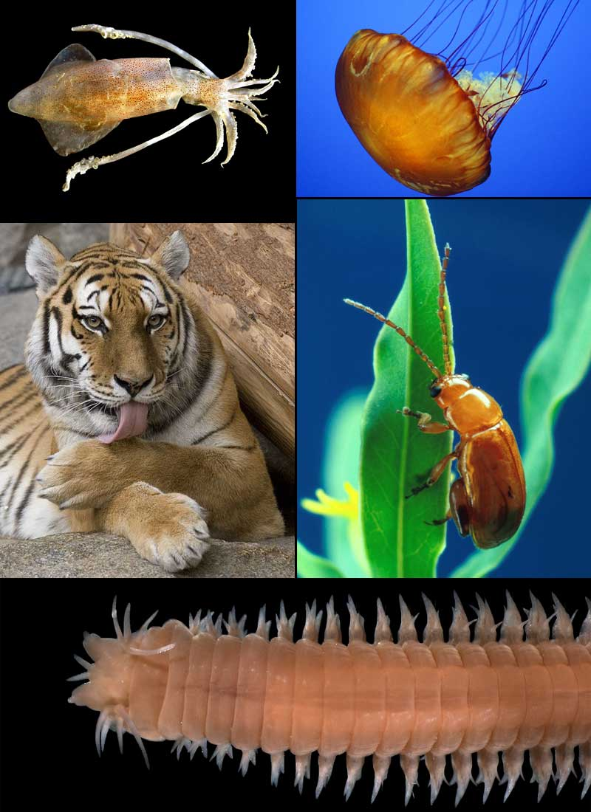
Kingdom Animalia
Multicellular
Heterotrophic
Cell membranes without cell walls
Incredible diversity

