Slide 1
Applying Mendel’s Principles
Genetics and Probability
Using the Punnett Square

Slide 3
Genetics and Probability
One of the most innovative things Mendel did was to apply the mathematical concept of probability to biology
Probability=the likelihood that a particular event will occur
Probability= the # of times a particular event occurs
The # of opportunities for the event to occur (# of trials)

Slide 4
Genetics and Probability
Why do you think Mendel worked with thousands of pea plants?
The greater the number of organisms studied, the more accurate the results.

Slide 5
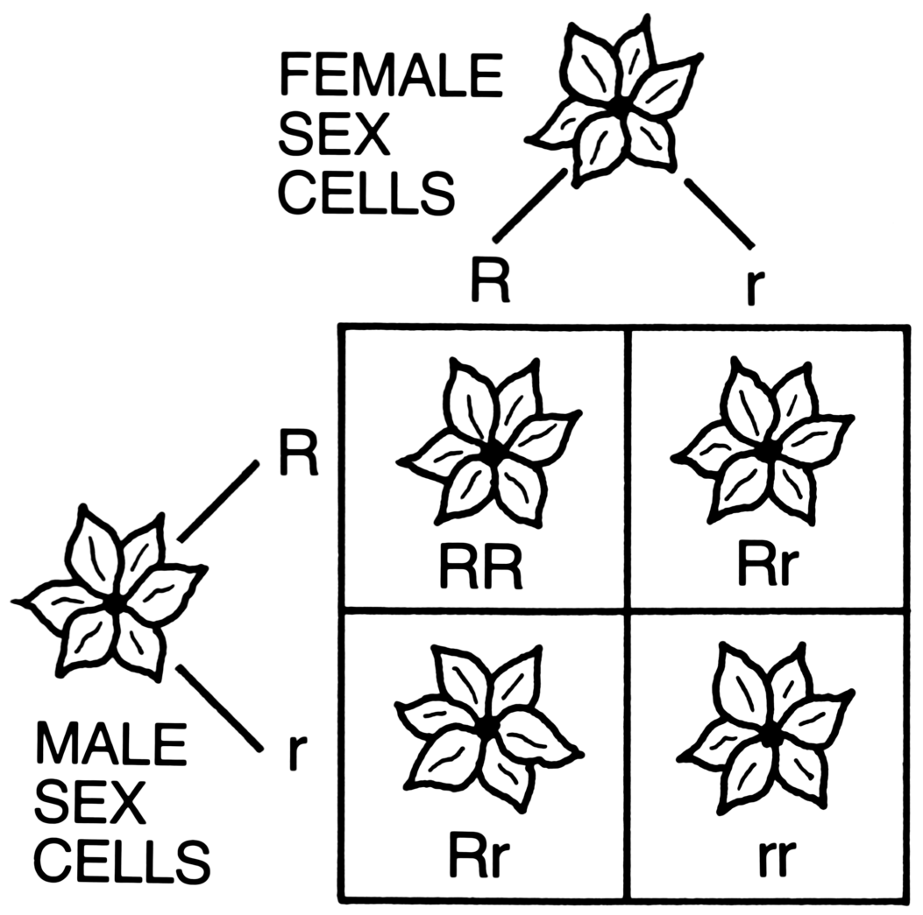
Using the Punnett Square
Chart showing the possible combinations of genes in the offspring of a cross

Slide 6
ONE-FACTOR CROSS
In pea plants,
Tall (T) is dominant over short (t)
You have a tall plant. Design a cross to see if this plant is homozygous (TT) or heterozygous (Tt)
Cross your tall plant with a short plant
The cross of an organism of unknown genotype and a homozygous recessive individual is called a test cross

Slide 7
Test cross
 | TT x tt
 | T | T
t | Tt | Tt
t | Tt | Tt
 | Tt x tt
 | T | T
T | Tt | Tt
T | Tt | tt

Slide 8
If any of the offspring resulting from a test cross shows the recessive phenotype, then the unknown parent must be heterozygous.

Slide 9
TWO-FACTOR CROSS
In pea plants, green pods (G) are dominant over yellow pods (g), and smooth pods (N) are dominant over constricted pods (n). A plant heterozygous for both traits (GgNn) is crossed with a plant that has yellow constricted pods (ggnn). What are the probably genotypic and phenotypic ratios for this cross?

Slide 10
 |  | GgNn x ggnn
 | GN | Gn | gN | Gn
gn | GgNn | Ggnn | ggNn | Ggnn
gn | GgNn | Ggnn | ggNn | Ggnn
gn | GgNn | Ggnn | ggNn | Ggnn
gn | GgNn | Ggnn | ggNn | ggnn

Slide 11
Solution!
Genotypic ratio=
4 GgNn : 4 Ggnn : 4ggNn : 4 ggnn = 4:4:4:4 = 1:1:1:1
Phenotypic ration=
4 green smooth : 4 green constricted : 4 yellow smooth : 4 yellow constricted = 4:4:4:4=1:1:1:1

Slide 12
Board Work XIX
What is probability?
What is a test cross?
What kind of cross produces a 9:3:3:1 ratio of offspring
A cross of F1 plants heterozygous for height should produce a ratio of tall to short plants of 3:1. Three seeds from such a cross produced three tall plants. What are the chances that a fourth seed will produce a short plant?

