Slide 1
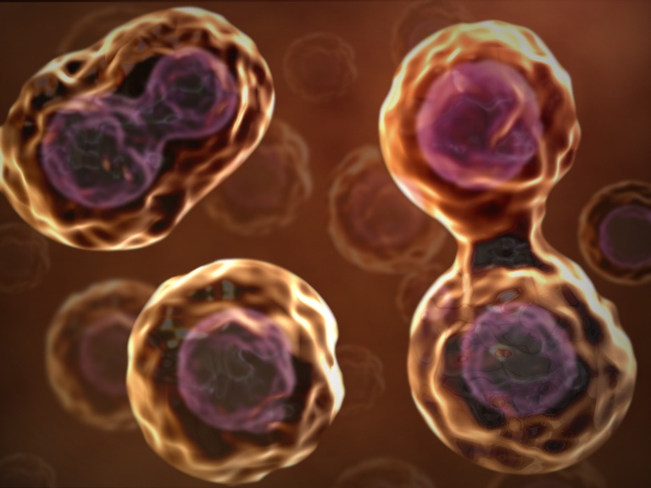
Cell Division: Mitosis and Cytokinesis
01-08-09
http://www.cellsalive.com/mitosis.htm

Slide 2
Cell Division
The division of eukaryotic cells occurs in two main stages
Mitosis is the first stage
Is the process by which the nucleus of the cell is divided into two nuclei, each with the same number and kinds of chromosomes as the parent cell
Cytokinesis is the second stage
Process by which the cytoplasm divides, thus forming two distinct cells

Slide 3
Cell Division
The division process is very complex because of the need to separate large amounts of DNA accurately and efficiently
A mistake in the process could make it impossible for one or both daughter cells to remain alive

Slide 4
Chromosomes
Structures in the cell that contain the genetic information that is passed on from one generation of cells to the next
Chromosomes=colored body
Not visible in most cells except during mitosis
Contain genetic info. In the form of DNA
In prokaryotic cells, the chromosomes are made up of long circular molecules of DNA
In eukaryotic cells, the chromosomes are made up of distinct lengths of DNA
The cells of every organism contain a specific number of chromosomes

Slide 5
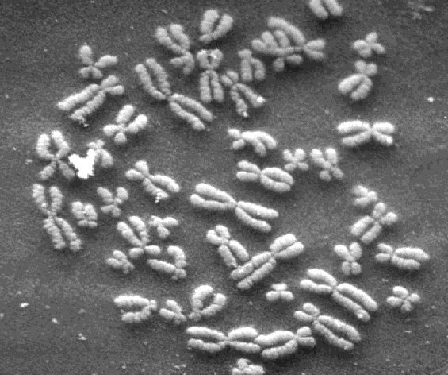
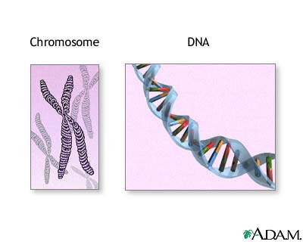

Slide 6
Composition of Chromatin
Chromosomes are made up of material called chromatin
Forms condensed and dispersed regions
During early stages of mitosis, the chromatic condenses and the chromosomes become visible
Composed of DNA and protein
1973, American Scientists Don Olins, Ada Olins, and Christopher Woodcock discovered that the chromosomes’ DNA was coiled around special proteins called histones
Together, the DNA and histone molecules formed beadlike structures called nucleosomes

Slide 7
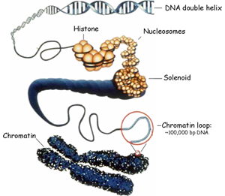

Slide 8
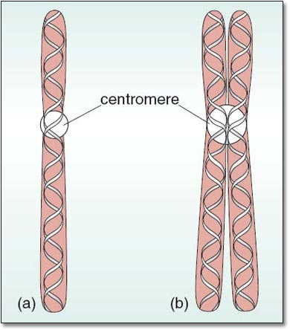
Chromosome Structure
After DNA replication, the chromosomes become visible by condensing (beginning of mitosis)
Contains two chromatids, or identical parts, which are often called sister chromatids
Attached at an area called centromere

Slide 9
Cell Cycle
Period from the beginning of one mitosis to the beginning of the next
During a cell cycle, a cell grows, prepares for division, and divides to form two daughter cells, each of which begins the cycle anew
Includes mitosis, a period of active division, and interphase, a period of nondivision
Includes processes in which cytoplasm and its contents divides, forming two daughter cells

Slide 10
Cell Cycle
Mitosis is represented as the M phase.
The nucleus divides into two nuclei
Interphase is divided into 3 phases: G1, S, G2
Periods of intense growth

Slide 11
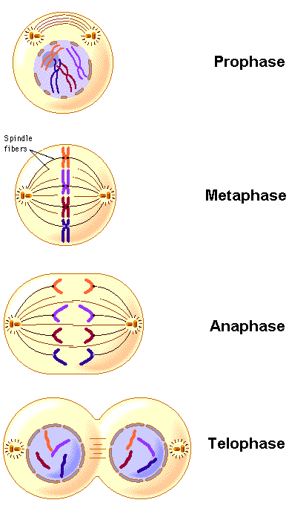

Slide 12
Cell Cycle
The time required to complete a single turn of the cell cycle is the time required for a cell to reproduce itself
Not all cells move through the cell cycle at the same rate
In human body, most muscle cells and nerve cells do not divide at all once they have developed
The cells that line the digestive system grow and divide rapidly
May pass through a complete cycle every six hours

Slide 13
Interphase
Period between cell division
Can be quite long
Divided into 3 phases
G1: period of activity in which cellular growth and development take place
S1: Synthesis of DNA, (DNA replication)several proteins associated with chromosomes are synthesized
G2: usually the shortest of the 3 phases of interphase
Involves the synthesis of organelles and materials required for cell division
During interphase, the nucleus is active in synthesizing messenger RNA in order to direct cellular activities

Slide 14
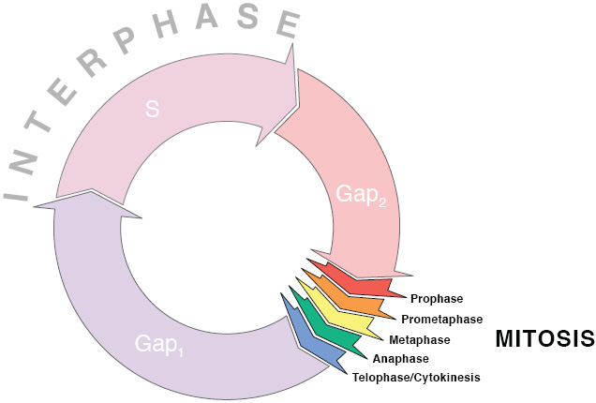
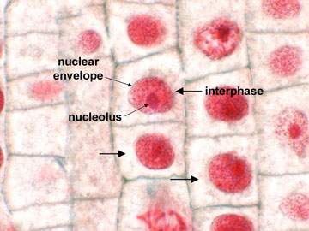
http://highered.mcgraw-hill.com/sites/0073031216/student_view0/exercise13/mitosis_movie.html#

Slide 15
Prophase
First phase of mitosis
Longest phase, frequently taking 50 to 60% of the total time required to complete mitosis
Chromosomes become visible as a result of condensing and coiling of the yarnlike chromatin
The centrioles separate from each other and take up positions on the opposite side of the nucleus
At end of prophase, the coiling of the chromosomes becomes tighter, the nucleus disappears and the nuclear envelope breaks down

Slide 16
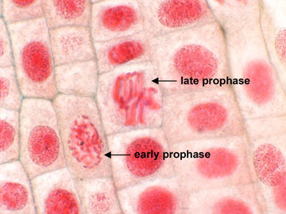
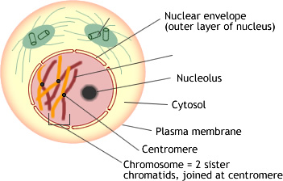
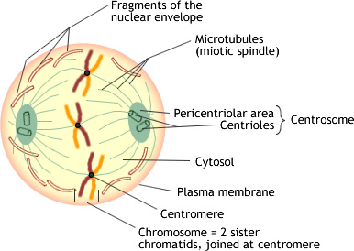

Slide 17
Metaphase
Shortest phase of mitosis
Only lasts a few minutes
The chromosomes line up across the center of the cell
The spindle fibers attach to the centromere of each chromosome

Slide 18
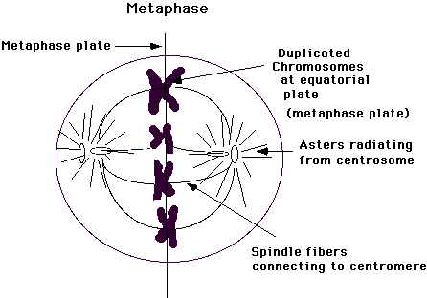
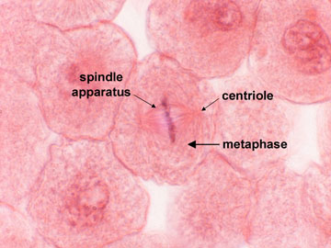

Slide 19
Anaphase
The 3rd phase of mitosis
Begins when the centromeres that join the sister chromatids split
Sister chromatids separate becoming individual chromosomes, the spindle fiber grows longer
Chromatids move closer to the centrioles at the poles
Anaphase ends when the movement of chromosomes stops

Slide 20
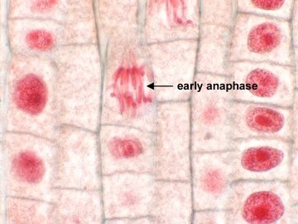
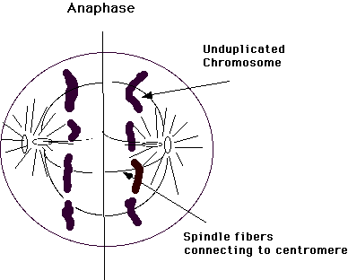

Slide 21
Telophase
The final phase of mitosis
Chromosomes begin to uncoil into a tangle of chromatin
This occurs in the two regions where the nuclei of the daughter cells will form
The nuclear envelope reforms around the chromatin, the spindle begins to break apart and nucleolus becomes visible in each daughter nucleus
Mitosis is now complete. The process of cell division is not.

Slide 22
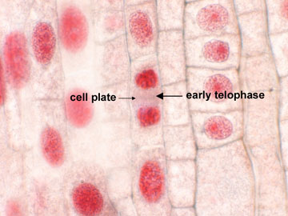
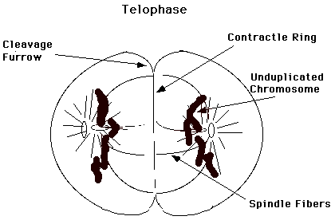

Slide 23
Cytokinesis
Division of cytoplasm into two individual cells
The cell membrane moves inward until the cytoplasm is pinched into two nearly equal parts, each part containing its own nucleus and cytoplasmic organelles

Slide 24
