Slide 1
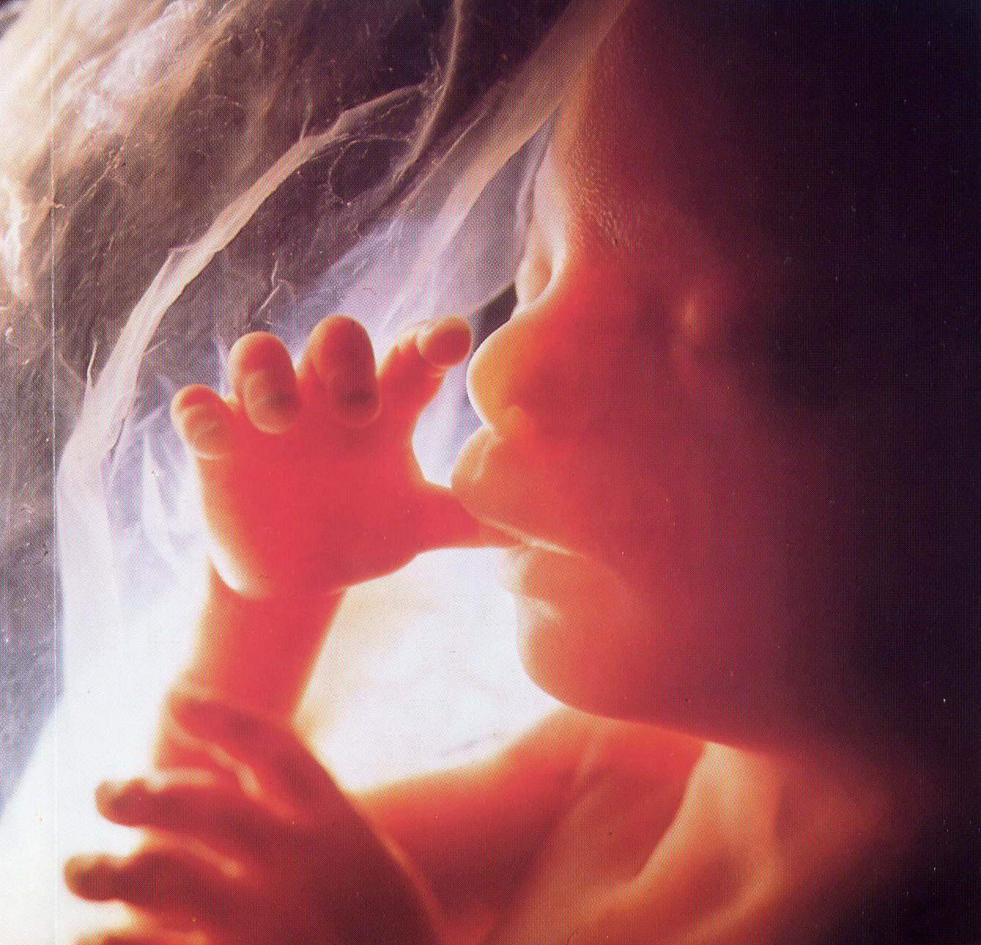
Reproduction and Development
The Reproductive System
Human Development

Slide 2
The Reproductive System
Sexual Development
The Male Reproductive system
The Female Reproductive System
The Menstrual Cycle
Fertilization

Slide 3
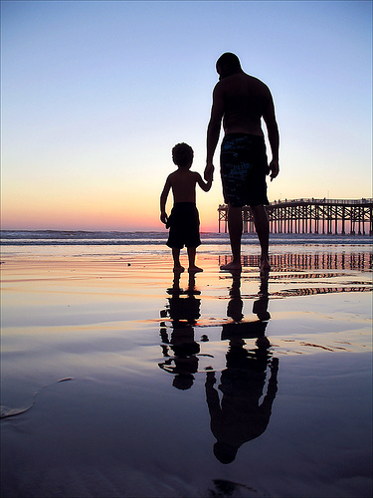
The Reproductive System
Reproductive system=group of specialized organs that carries out the function of reproduction
Single most important system to the continuation of a species
Organism produces the next generation

Slide 4
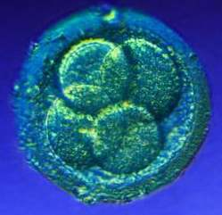
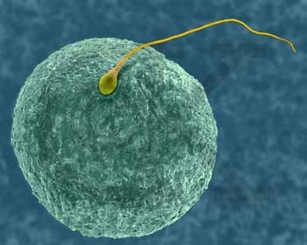
The Reproductive System
Produces, stores, nourishes, and releases specialized sex cells known as gametes
Released in ways that make possible the fusion of egg and sperm
Zygote=fertilized egg cell

Slide 5
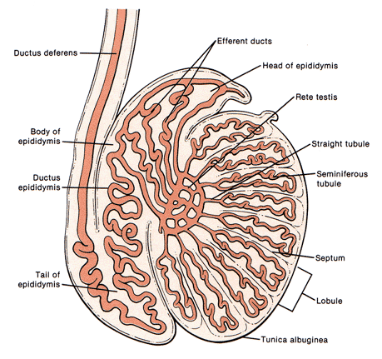
Sexual Development
Human male and female embryo are identical in the first six weeks after fertilization
Major changes occur in seventh week
Testes begin to produce steroid hormones known as androgens
Tissues of embryo respond by developing into male reproductive organs

Slide 6
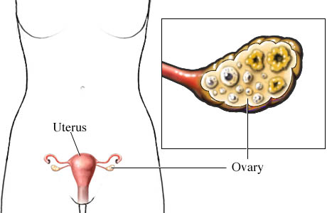
Sexual Development
If the embryo is female
Ovaries produce steroid hormones known as estrogens
Tissues of embryo develop in a pattern that produces female reproductive organs

Slide 7
Sexual Development
After birth, testes and ovaries continue to produce small amounts of androgens and estrogens
Cont to influence the development of the reproductive organs
Neither testes nor ovaries can produce active reproductive cells

Slide 8
Sexual Development
Puberty
Period of rapid growth and sexual maturation
Reproductive system becomes fully functional
Completion
Gonads are fully developed
Onset varies
Anytime between 9 to 15
Earlier in females

Slide 9
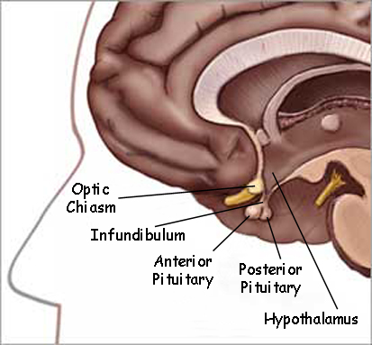
Sexual Development
Puberty
Begins with a change in the hypothalamus
Part of brain that regulates the secretions of the pituitary gland
Causes pituitary gland to produce increased levels of FSH and LH

Slide 10
The Male Reproductive System
Reproductive organs
Testes
Just before birth the testes descent through a canal into an external sac called the scrotum
1 to 3 below the internal body temp
Clusters of hundreds of tiny tubules called seminiferous tubules
Seminiferous=seed bearing
Sperm are produced
Tightly coiled and twisted together to form a compact organ
As FSH and LH are released, they stimulate the testes to make testosterone

Slide 11
The Male Reproductive System
Testosterone
Cells that can respond are found all over the body
Produces a number of secondary sex characteristics
Appear in males at puberty
Voice deeper
Facial hair
Chest broadens
Easier to develop muscles

Slide 12
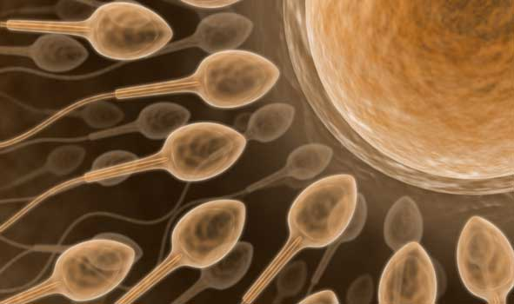
The Male Reproductive System
Sperm
FSH and testosterone stimulate the development of sperm
Puberty is complete when large numbers of sperm have been produced in the testes
Reproductive system now function
Can produce and release active sperm

Slide 13
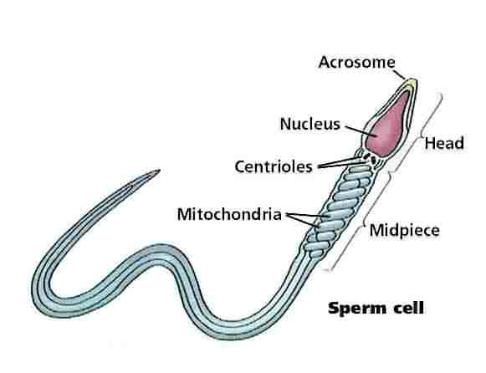
Sperm Development
Derived from special cells within the testes that go through the process of meiosis to for the haploid nuclei found in mature sperm
Consists of
Head-contains the highly condensed nucleus
Midpiece-packed with energy-releasing mitochondria
Tail-propels the cell forward
Cap- enzyme vital to the process of fertilization

Slide 14
Sperm Development
Developed sperm travel from the seminiferous tubules into the epididymis
Fully mature and stored
Forced into vas deferens
Passes into the abdominal cavity
3 glands produce seminal fluid
Semen
Merges with the urethra
Leads to the outside of body through the penis

Slide 15
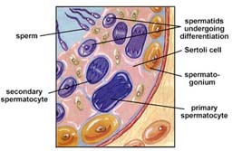
Sperm Development
100 to 200 million sperm are present in 1 milliliter of semen
5 million sperm per drop

Slide 16
Sperm Release
When male is sexually excited, autonomic nervous system prepares the male organs to deliver sperm
Sperm are ejected from the penis by the contractions of smooth muscles lining the vas deferens
Ejaculation
Not completely voluntary
~2 to 3 milliliters of sperm

Slide 17
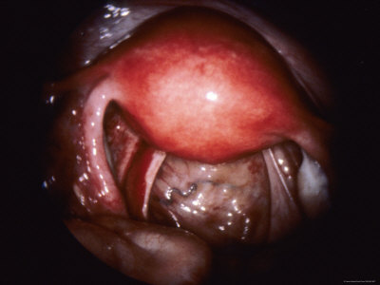
Female Reproductive System
Primary reproductive organs
Ovaries
Located in abdominal cavity
Produce one egg (ovum) per month
Prepare to nourish a developing embryo

Slide 18
Female Reproductive System
Puberty
Starts with changes in the hypothalamus
Cause release of FSH and LH from the pituitary gland
Same hormones found in males
Target cells and effects different
FSH-stimulates cells within the ovaries to produce hormones known as estrogens
Cause reproductive system to complete its development
Produce secondary sex characteristics
Breast development
Enlargement of reproductive organs
Widening of hips
Hair growth under arms and in pubic areas

Slide 19
Ova Development
Each ovary contains about 400,000 primary follicles
Clusters of cells surrounding a single ovum
Prepare a single ovum for release
mature within their follicles
Female born with about 400,000 immature ova in her ovaries
Fewer than 500 will actually be released
FSH influences ovum to complete meiosis and increase in size
As nutrients are added to its cytoplasm

Slide 20
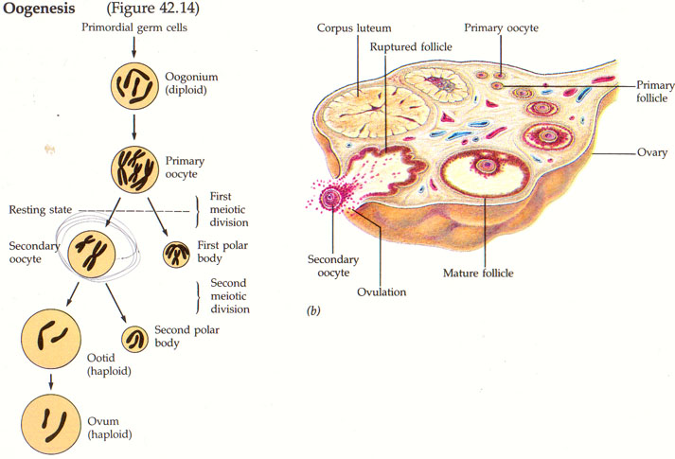

Slide 21
Ovulation
When follicle has completely matured, the ovum is released
Ovulation
Follicle literally ruptures
Ovum is swept from the surface of the ovary into the opening of one of the two Fallopian tubes
Ovum moves through the fluid-filled Fallopian tubes, pushed along by cilia
Egg can be fertilized during this journey
After a few days, ovum arrives at the uterus
Uterus opens into vagina which leads to the outside of the body

Slide 22
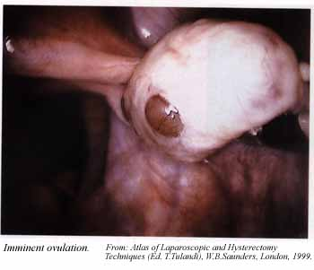

Slide 23
Ovulation
Begins at puberty and continues till late 40’s
Menopause occurs
Follicle development no longer occurs and female is no longer capable of bearing a child

Slide 24
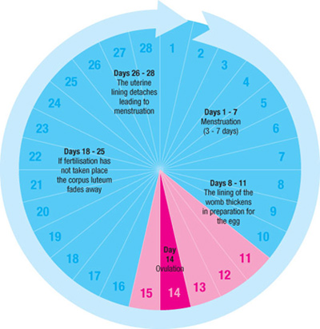
The Menstrual Cycle
The interaction of the reproductive system and the endocrine system
Complex series of periodic events
In females
About 28 days
Latin, mensis=month

Slide 25
The Menstrual Cycle
Controlled by hormones
The development and the release of an egg for fertilization and the preparation of the uterus to receive a fertilized egg
Egg not fertilized…it is discharged along with the lining of the uterus
4 phases
Follicle phase
Ovulation
Luteal phase
menstruation

Slide 26
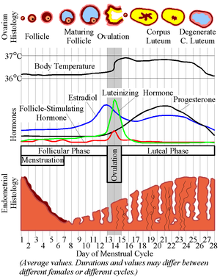

Slide 27
Follicle Phase
Begins when estrogen levels are low
Hypothalamus reacts by producing a releasing hormone that acts on the pituitary gland
Stimulates FSH and LH into the blood
Travel through the circulatory system to the ovaries where they cause a follicle to develop to maturity
As follicle develops, cells around ovum enlarge and produce more estrogen
Estrogen level rise dramatically
Causes lining of uterus to thicken
10 days

Slide 28
Ovulation
Shortest of menstrual cycle
Occurs at 14 days
Lasts 3-4 days
Hypothalamus send a large amount of releasing hormone to the pituitary gland
Pituitary gland produces a sudden rush of FSH and LH
Dramatic effect on the follicle
It ruptures
Mature ovum is released

Slide 29
Luteal Phase
10-14 days after the completion of the last menstrual cycle
Ruptured follicle is now known as corpus luteum
Continues to release estrogen
Begins to release progesterone
Adds finishing touches to uterus lining
Blood supply is increased
Tissue matures
Lining is fully prepared to accept a fertilized ovum
First 2 days of luteal phase, chances of getting pregnant is greatest!

Slide 30
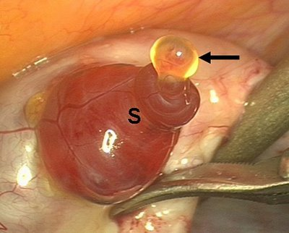

Slide 31
Luteal Phase
Ovum is fertilized by a sperm
Resulting zygote starts to divide
After several divisions…ball of cells will implant itself in the lining of the uterus
Within a few days of implantation…the uterus and growing embryo will release hormones that keep the corpus luteum functioning for several weeks
Allows the lining of the uterus to nourish and protect the developing embryo

Slide 32
Menstruation
Fertilization does not occur
Within 2-3 days of ovulation
Ovum passes through the uterus without implantation
Corpus luteum begins to disintegrate
As old follicle breaks down, it releases les and less estrogen and progesterone
Hormone level in blood decreases

Slide 33
Menstruation
When estrogen levels fall below a certain point, lining of uterus begins to detach from the uterine wall
This tissue along with blood from the unfertilized ovum are discharged through the vagina in the last phase of the menstrual cycle=menstruation
3-7 days, average=4
At end, new cycle begins

Slide 34
Fertilization
Sperm must be present in the female reproductive tract
Fallopian tube
Sperm are released during sexual intercourse
Semen is ejaculated through the penis into the vagina
To cervix
Sperm swim actively through the uterus and up into the Fallopian tubes
Only a few of the hundreds of millions of sperm will reach the ovum
Only a single sperm will fertilize the ovum

Slide 35
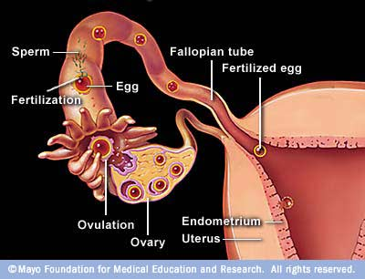

Slide 36
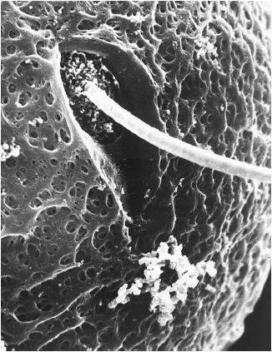

Slide 37
Fertilization
Ovum is surrounded by a dense protective layer that contains receptor sites to which sperm bind
Binding causes a vesicle in the sperm head to rupture and release enzymes that break down the protective layer and form a pathway through which the sperm nucleus can reach the ovum
Cell membrane of the ovum changes
Preventing other sperm from entering the cell

Slide 38
Fertilization
Zygote=fertilized egg
After two haploid nuclei fuse to form a single diploid nucleus
Goes through several rounds of cell division
Ball of cells will attach itself to the wall of the uterus and begin to grow into an embryo

Slide 39
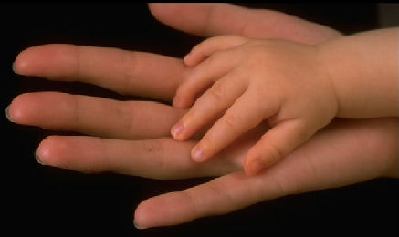
Human Development
Early Development
Later Development
Childbirth
After Childbirth

Slide 40
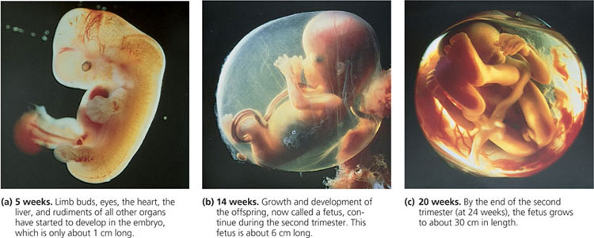
Human Development
Begins when an ovum is fertilized
Cell the size of this . Will undergo cell divisions that will result in the formation of a new human being

Slide 41
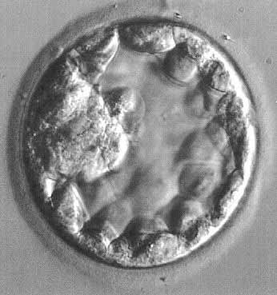
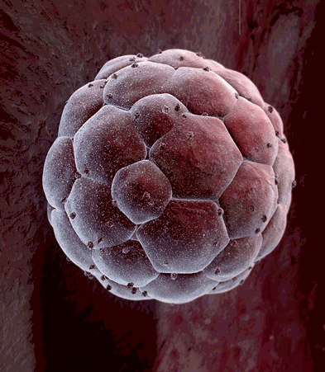
Early Development
Mitotic cell divisions of the zygote=cleavages
Take place while the zygote is still in a Fallopian tube
4 days after fertilization
Embryo is solid ball of about 50 cells
Morula
As embryo grows, a fluid-filled cavity forms in the center, transforming it into a hollow structure known as a blastocyst
6-7 days after fertilization
Blastocyst attaches itself to the wall of the uterus and begins to grow inward
implantation

Slide 42
Early Development
Cluster of cells forms within the cavity of the blastocyst
Sorts itself into 2 layers
Then produce a 3rd layer
Gastrulation
Result is the formation of three cell layers
Ectoderm
Mesoderm
Endoderm
Primary germ layers
Organs and tissues will be formed from these

Slide 43
Early Development
During implantation
Outer layer of cells of the blastocyst produces two membranes that surround, protect, and nourish developing embryo
Amnion
chorion

Slide 44
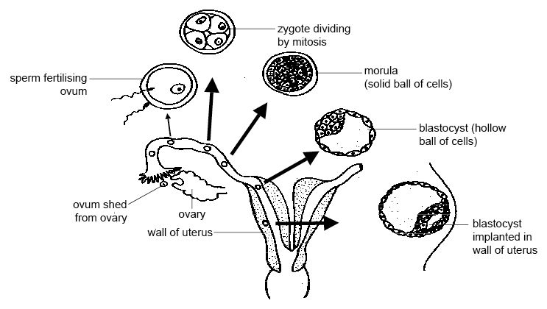

Slide 45
Early Development
End of 3rd week of development
Nervous system and digestive system have begun to form
Chorion has grown into the uterine tissue
Forms placenta
Connection between the mother and developing embryo
Needs a supply of nutrients and oxygen
Means of eliminating carbon dioxide and metabolic wastes
Blood of mother and embryo flow past each other, but do not mix
Thin membrane for diffusion of gases, food, waste

Slide 46
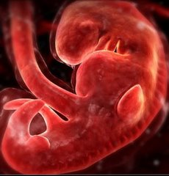

Slide 47
Early Development
8 weeks
Embryo is known as a fetus
3 months
Most of major organs and tissues of the fetus are fully formed
Umbilical cord forms
Contains two arteries, one vein
Connects the fetus to the placenta
Muscular system well developed
Fetus may begin to move
Show signs of reflexes
Fetus about 9 cm long
Mass of about 15 grams
Amnion developed into a fluid-filled sac
Amniotic sac
Cushions and protects the developing fetus

Slide 48
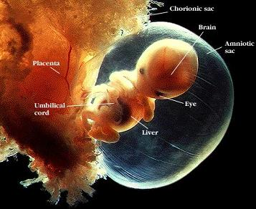
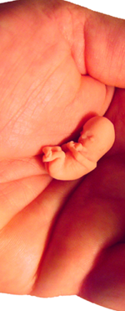
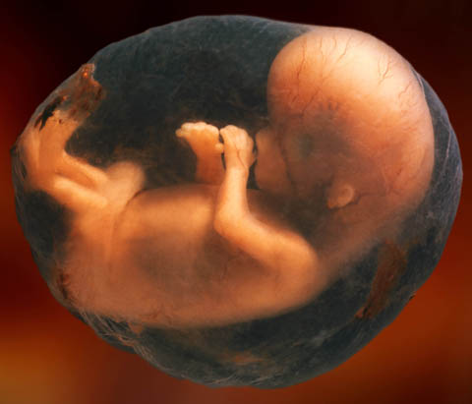
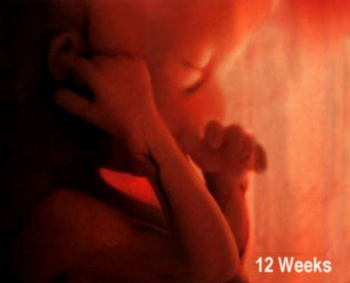

Slide 49
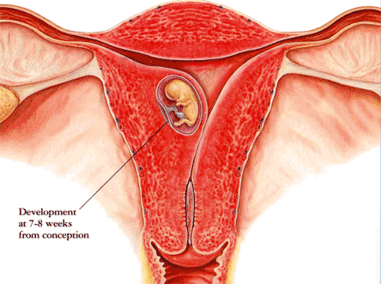

Slide 50
Later Development
During 4th, 5th, and 6th months
Tissues of fetus continue to become more complex and specialized
Skeleton begins to form
Fetal heart beat becomes strong enough to be heard by a stethoscope
Layer of soft hair grows over fetus’s skin
As fetus increases in sizes so does the mothers abdomen
Fetus is about 35 cm in length with a mass of about 700 grams by the end of the 6th month

Slide 51
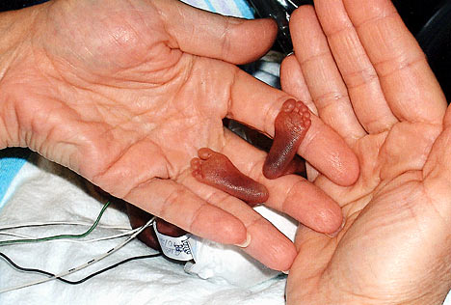
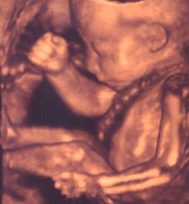
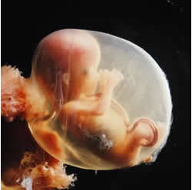
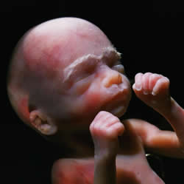

Slide 52
Later Development
Fetus is capable of leading a completely independent existence during the final 3 months
Months are important
Fetus doubles in mass
Lungs and other organs undergo a series of changes that prepare them for life outside the mother
Premature babies (before 8 months) have difficult time breathing because lungs are not fully developed

Slide 53
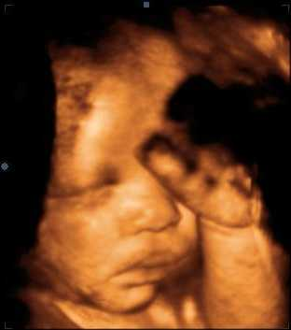
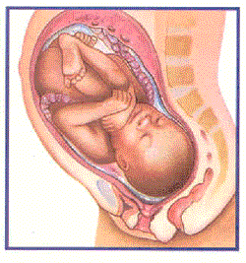
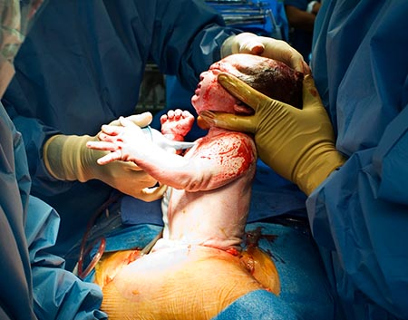
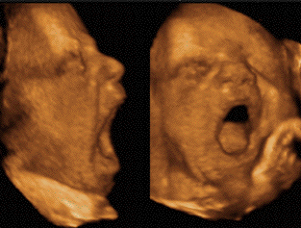

Slide 54
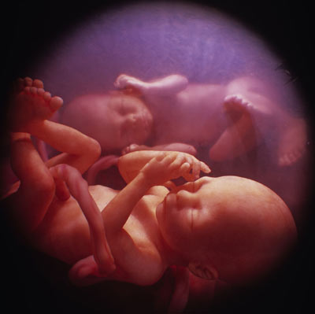
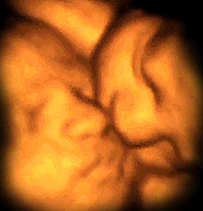

Slide 55
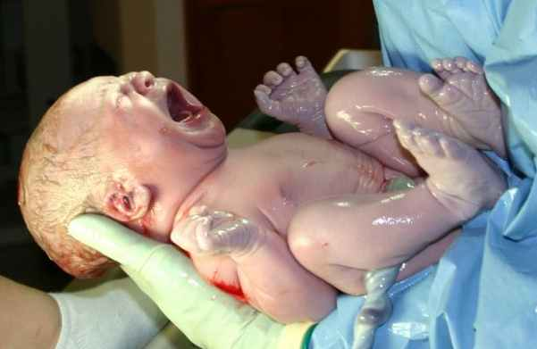
Childbirth

Slide 56
Childbirth
About 9 months after fertilization
End of full-term pregnancy
Fetus is ready for birth
How process is triggered is unknown
Oxytocin is released from the pituitary gland
Effects group of large involuntary muscles that surround the uterus
Muscles are stimulated, begin a series of rhythmic contractions known as labor that expand the opening of the cervix (about 10 cm) to allow the baby to pass through it

Slide 57
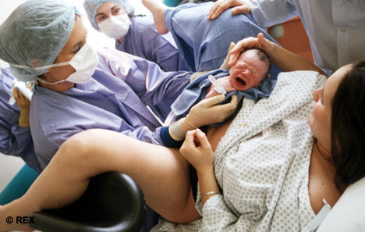
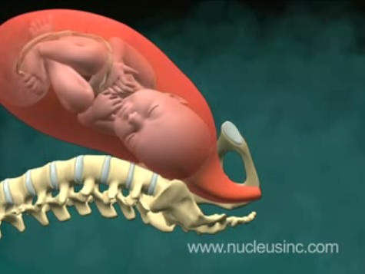
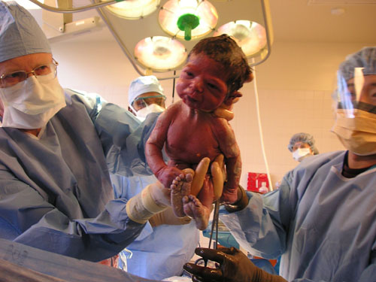

Slide 58
Childbirth
As contractions continue they become more powerful and more frequent
Once every 1-2 min
Last 2-16 hours
baby is forced toward the vagina
Amniotic sac breaks
Fluid rushes out vagina
Baby forced out of the uterus and the vagina
Usually head first still attached to its mother by the umbilical cord

Slide 59
Childbirth
As baby meets outside world
May cough or cry to rid lungs of fluid
Breathing starts almost immediately
Blood supply to placenta begins to dry up
Umbilical cord clamped and cut
Scar=navel
Placenta and amniotic sac are expelled with more contractions
afterbirth

Slide 60
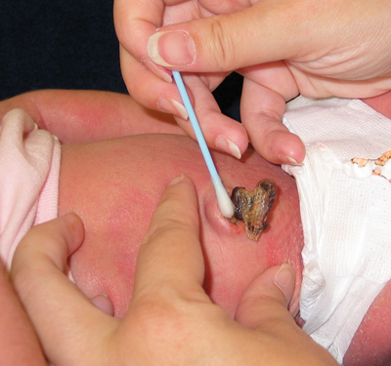
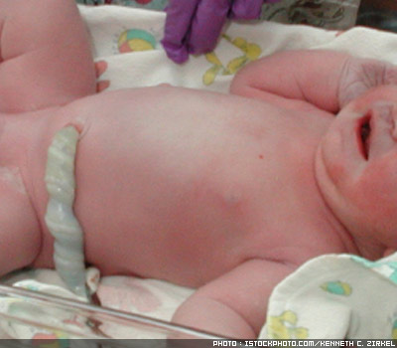

Slide 61
After Childbirth
Within a few hours
Pituitary hormone, prolactin stimulates milk production in the breast tissue
If mom breastfeeds
Milk is always ready when needed
Stops whenever breastfeeding stops
Stimulation of nerve cells in the breast transmit impulses to the hypothalamus
Causes pituitary gland to release nearly 10 times the normal amount of prolactin
Enables milk production

Slide 62
