Slide 1
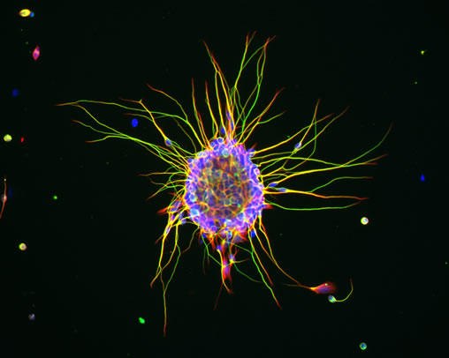
The Cell Theory
09/23/08

Slide 2
The Cell Theory
Curiosity led early investigators to examine living things under lenses & microscopes in the hope of getting a better glimpse of their structure
Little by little, their findings led to the most fundamental of all discoveries about the nature of living things:
All living things are made of cells
Cells=the basic unit of structure & function in living things

Slide 3
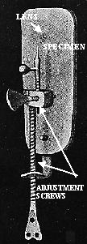
The Cell Theory
The first lenses were used in Europe hundreds of years ago by merchants who needed to determine the quality of cloth
In Holland in the early 1600’s, two useful instruments were constructed:
Telescope
Microscope

Slide 4
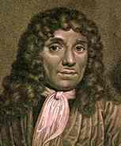
The Cell Theory
The person given credit for first microscope was Anton van Leeuwenhoek, a Dutch biologist
His invention enabled him to see things that no one had ever seen before
He carefully observed the tiny things living in pond water & made detailed drawings of each kind of organism
His work interested other people in building microscopes

Slide 5
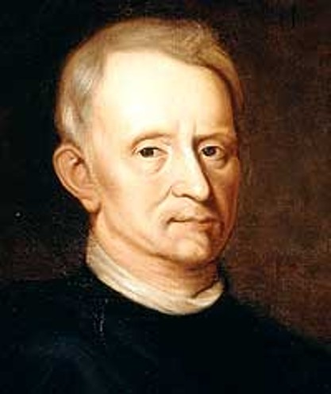
The Cell Theory
Englishman, Robert Hooke, used one of his microscopes to look at thin slices of plant stems, wood, & pieces of cork
Looking at the cork, Hooke saw that is was composed of thousands of tiny chambers
He called these chambers cells because they reminded him of the small rooms called cells in the monastery
Unfortunately, Hooke was not looking at living cells. He was looking at the nonliving outer walls of what had once been living plant cells
Hooke’s discovery was significant because it opened up the study of cells

Slide 6
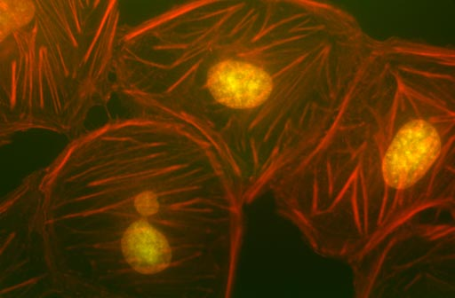
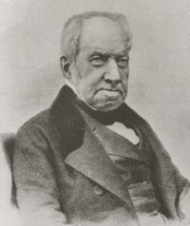
The Cell Theory
Over the next 200 years, other scientists began to discover that cells were not only found in plants but in other living things too
1883, Robert Brown, a Scottish scientist, observed that many cells seemed to have a dark structure near the center of the cell
Now called the nucleus

Slide 7
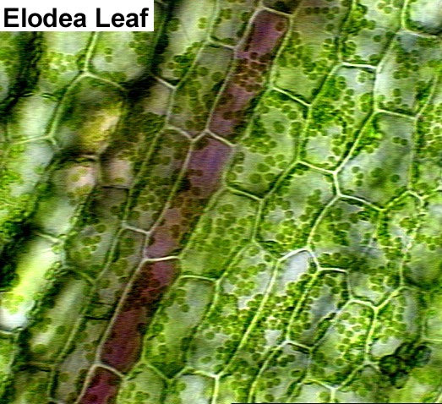
The Cell Theory
5 years later, German botanist Matthias Schleiden stated that all plants are made of cells
Next year, Theodor Schwann discovered that all animals are made of cells too
1855, Rudolf Virchow, a German physicist, stated that all cells arise from the division of pre-existing cells

Slide 8
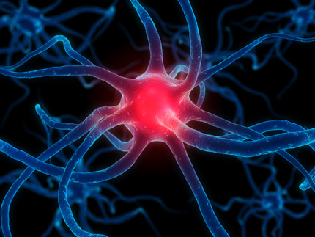
The Cell Theory
Today, the observations & conclusions of these scientists are summarized into the cell theory
The cell theory forms the basic framework in which biologists have tried to understand living things ever since
The cell theory:
All living things are composed of cells
Cells are the basic units of structure & function in living things
All cells come from pre-existing cells

