Slide 1
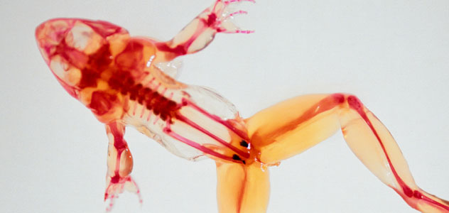
Biology: The Study of Life
09-10-08

Slide 2
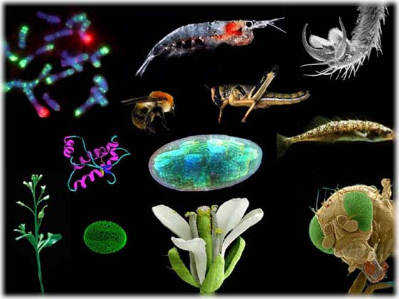
Biology: The Study of Life
Biology means the study of life.
Prefix bio- means life
Suffix –logy means study

Slide 3
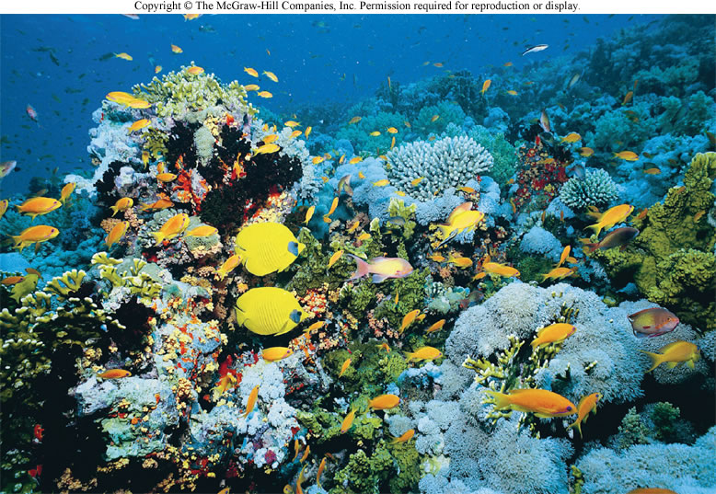
Biology: The Study of Life
Biology is the science that seeks to
Understand
Explain
Control the living world

Slide 4
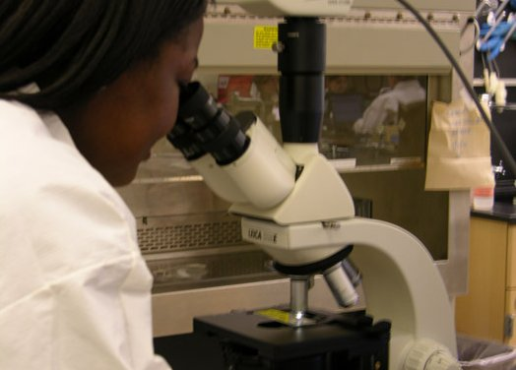
Biology: The Study of Life
Biology, like any other science,
Advances by observing the world
Asking questions
Forming hypotheses that can be tested by experimentation

Slide 5
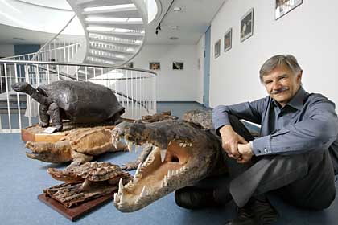
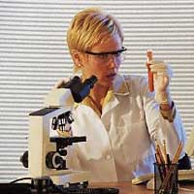
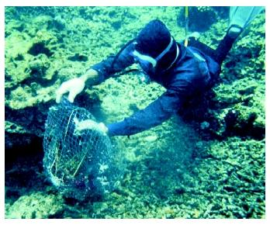
Biology: The Study of Life
A biologist is anyone who uses the scientific method to study living things

Slide 6
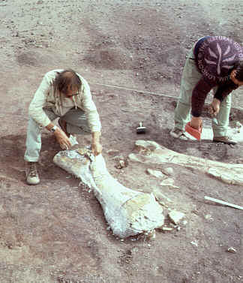
Branches of Biology
The broad field of biology contains many branches, or subdivisions
Zoologists-study animals
Botanists-work with plants
Microbiologists-work with microscopic organisms
Other subdivisions of biology are more focused
Paleontologists-work with extinct organisms
Ethologists-study animal behavior

Slide 7
Types of questions asked by different biologists
Questions at the Molecular Level
Questions at the Cellular Level
Questions at the Multicellular Level
Questions at the Population Level
Questions at the Global Level

Slide 8
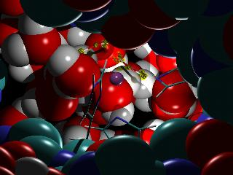
Questions at the Molecular Level (molecular biologists)
Study the basic chemical units of life
Workings of DNA-the molecule that controls heredity and directs all the activities of the cell
Study the effects of drugs on molecules in cells
To understand why entire organisms react to those drugs as they do

Slide 9
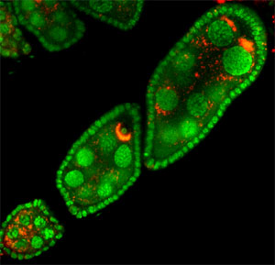
Questions at the Cellular Level (cell biologists)
Study the way normal cells become cancer cells when exposed to radiation or to the chemicals found in cigarette smoke
Try to explain how a single cell divides and changes to form all the cell types in an adult organism
How cells communicate with nearby cells

Slide 10
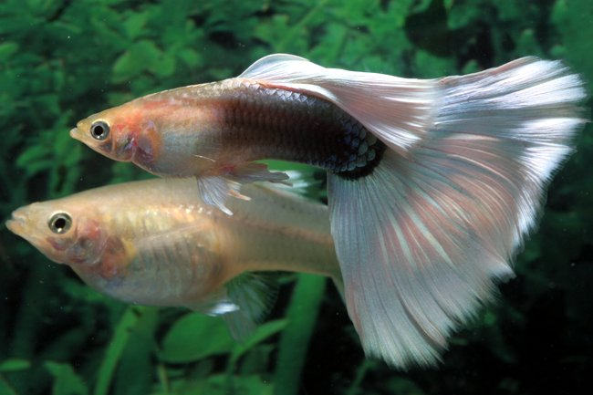
Questions at the Multicellular Level
Might be interested in the changes within animals that tell them when to sleep or eat or even when to mate (zoologists)
Try to explain how certain animals changed over time, or evolved (paleontologists)
Ask why the males of a particular kind of organism are more brightly colored that the females(ethologists)

Slide 11
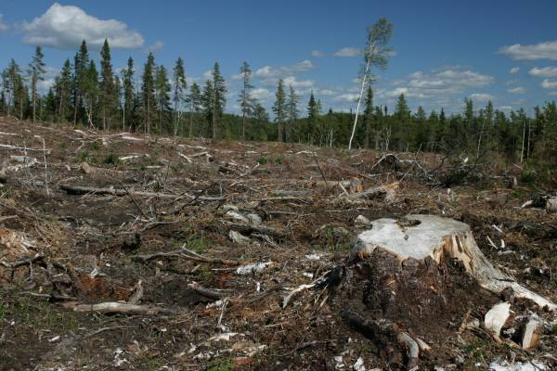
Questions at the Population Level
Interested in groups of organisms that make up populations and how such populations interact with their environment
Want to know how the construction of a new road or dam, or the cutting down of forests, will affect nearby plant and animal life
Effects of pesticides or industrial wastes on organisms that live in our waterways

Slide 12
Questions at the Global Level
A more worldwide view of biology
Concerned with organisms and their environment on a global scale
Try to estimate the effects on the Earth’s climate of burning coal and oil (ecologists)

Slide 13
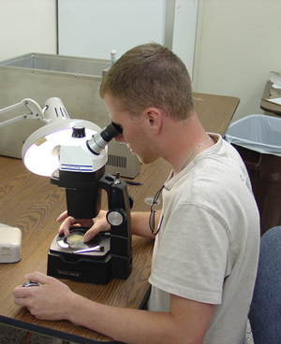
Biology: The Study of Life
Whether studying questions at the molecular level, the global level, or a level in between, biologists are making important contributions
Yes, most biologists have been to college for many, many years
However, anyone can be a biologist
Requires hard work
Curiosity
Energy
Today, many amateurs, including high school and college students, continue to make important contributions to scientific research and the study of biology

Slide 14
Biology is filled with terms that may seem unfamiliar to you but are actually quite simple Many scientific terms are derived from Latin or Greek words that may be added in front of another word as a prefix or after another word as a suffix
PREFIX | MEANING | PREFIX | MEANING | SUFFIX | MEANING
Anti- | Against | Herb- | Pertaining to plants | -cyst | Pouch
Arth- | Joint, jointed | Hetero- | Different | -derm | Skin, layer
Auto- | Self | Homeo- | Same | -gen | Producing
Bio- | Related to life | Macro- | Large | -it is | Inflammation
Chloro- | Green | Micro- | Small | -logy | Study
Cyto- | Cell | Multi- | Consisting of many cells | -meter | Measurement
Di- | Double | Osteo- | Bone | -osis | Condition, disease
Epi- | Above | Photo- | Pertaining to light | -phase | Stage
Exo- | Outer, external | Plasm- | Forming substance | -phage | Eater
Gastro- | Stomach | Proto- | First | -pod | Foot
Hemo- | Blood | Syn- | Together | -stasis | Stationary condition

Slide 15
Board Work IV Use the prefix/suffix chart to determine what the following words mean:
Cytology 11. Antigen
Arthritis 12. Biology
Dipod 13. Cytogen
Macrophage 14. Epiderm
Microphage 15. Exocyst
Gastropod 16. Gastritis
Homeostasis 17. hemocyst
Osteoarthritis 18. Synpod
Heteroderm 19. Heteroderm
Multipod 20. Microsis

