Slide 1
Meiosis
Chromosome number
Phases of meiosis
Meiosis and genetics
Gamete formation
Comparing mitosis and meiosis

Slide 2
Chromosome number
A cell in adult drosphilia (fruit fly) has 8 chromosomes, 4 of which came from the fly’s male parent, and 4 of which came from the fly’s female parent.
These two sets of chromosomes are said to be homologous
Homologous=description of chromosomes that occur in pairs, each of the 4 chromosomes from the male parent has a corresponding chromosome from the female parent

Slide 3
Chromosome number
Diploid=description of a cell that contains a double set of chromosomes, one from each parent (2N)
For drosphilia, the diploid number is 8 or 2N=8
Diploid cells contain two complete sets of chromosomes and two complete sets of genes
This agrees with Mendel’s idea that all an organism’s cells (except gametes) contain two alleles for a given trait

Slide 4
Chromosome number
Haploid= containing a single set of chromosomes
The gametes of sexually reproducing organisms (including fruit flies and peas) contain only a single set of chromosomes (and genes)
Such cells are said to be haploid
For drosphilia, we write N=4, meaning that the haploid number is 4

Slide 5
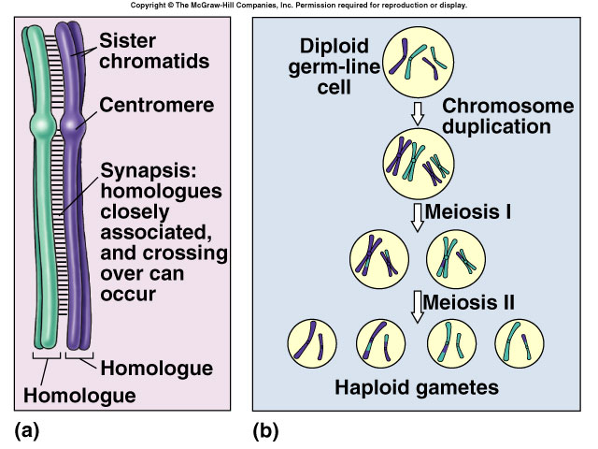

Slide 6
The Phases of Meiosis
How are haploid (N) gamete cells produced from diploid (2N) cells?
That is where meiosis comes in
Meiosis= a process of reduction division in which the number of chromosomes per cell is cut in half and the homologous chromosomes that exist in a diploid cell are separated

Slide 7
The Phases of Meiosis
Diploid cells go through two rounds of cell division known as the first meiotic division and the second meiotic division.
By the time the second meiotic division is complete, the diploid cell that entered meiosis has produced 4 haploid cells

Slide 8
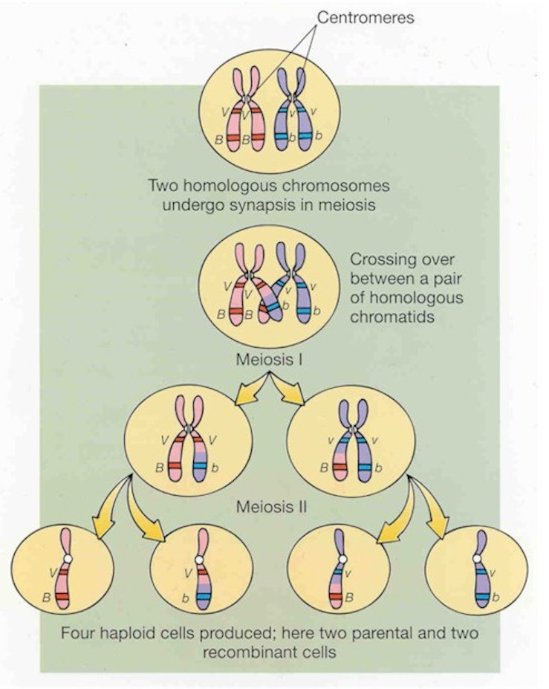
http://www.youtube.com/watch?v=SMve1h4Wlbo&feature=related

Slide 9
Meiosis I
Prior to entering the 1st meiotic division, cells undergo a round of DNA replication.
The cells then begin to divide in a way that looks like mitosis

Slide 10
Meiosis I
In mitosis, the 8 chromosomes line up individually in the center of the cell. The two chromatids that make up each chromosome then separate from each other.
In prophase of Meiosis I, each chromosome pairs with its corresponding homologous chromosome to form a special structure called a tetrad
Tetrad=comes from the Greek word tetra, which means 4
There are four chromosomes in a tetrad
****The pairing of homologous chromosomes is the key to understanding meiosis *****

Slide 11
Meiosis I
As the homologous chromosomes pair up and form tetrads in meiosis I, they may exchange portions of their chromatids in a process called crossing-over.
Crossing-over=process by which homologous chromosomes exchange portions of their chromatids during meiosis
Crossing-over results in the exchange of genes between homologous chromosomes and produces new combinations of genes.

Slide 12
Meiosis I
Next, the homologous chromosomes separate and two new cells are formed
Each cell now has 8 chromatids (just as it would in normal mitosis) except something is different.
Because each pair of homologous chromosomes separated, neither of the daughter cells has the two complete sets of chromosomes expected of a diploid cell
The two cells produced have sets of chromosomes (and genes) that are different from each other, and different from the diploid cell that entered the first meiotic division.

Slide 13
Meiosis II
The two cells produced by meiosis I now enter a second meiotic division, Meiosis II
Neither cell undergoes DNA replication before entering meiosis II
The chromosomes contain 2 chromatids
Metaphase II of meiosis, 4 chromosomes line up in the center of each cell
Anaphase II of meiosis, the paired chromatids separate
Each daughter cell receives 4 chromatids
The 4 daughter cells now contain the haploid number (N) just 4 chromosomes each

Slide 14
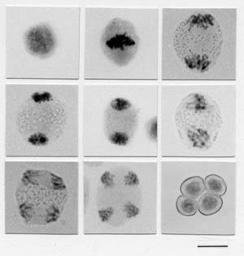

Slide 15
Gamete formation
Male animals→the haploid gametes produced by meiosis→sperm
In higher plants, pollen grains contain haploid sperm cells
Female animals→usually only one of the cells produced by meiosis is used for reproduction→egg→higher plants→ovule

Slide 16
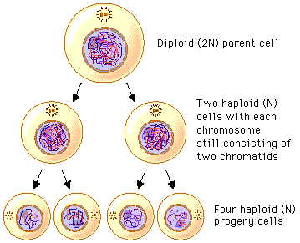

Slide 17
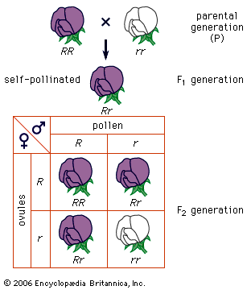

Slide 19
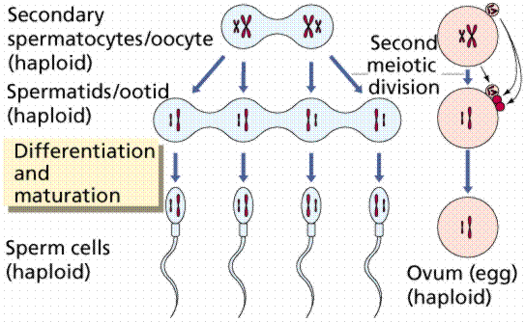

Slide 20
Comparing mitosis and meiosis
Mitosis
Meiosis
results in the production of two genetically identical cells
A diploid cell divides and creates two diploid (2N) daughter cells
Daughter cells have sets of chromosomes (and genes) identical to each other and to the original parent cell
Begins with a diploid cell but produces 4 haploid (N) cells
Daughter cells are genetically different from the diploid cell and from one another because homologous chromosomes are separated during the first meiotic division and because crossing-over results in the production of new gene combinations on the chromosomes
http://www.youtube.com/watch?v=l25s8CgUHZM&feature=related

Slide 21
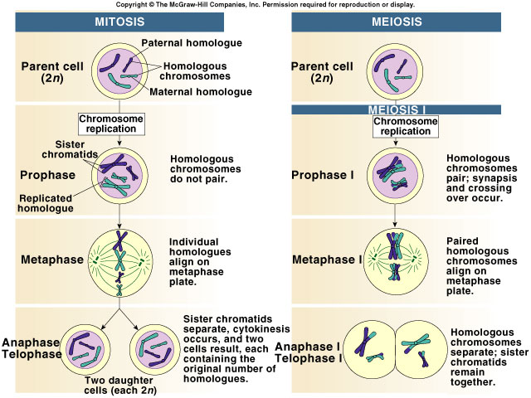

Slide 22
Board Work 20
What is meiosis?
Define diploid and haploid.
In which meiotic division does segregation occur?
What are the principal differences between mitosis and meiosis?
In human cells, 2N=46. How many chromosomes would you expect to find in a sperm cell? In an egg cell? In a white blood cell? Explain your answers.

