Slide 1
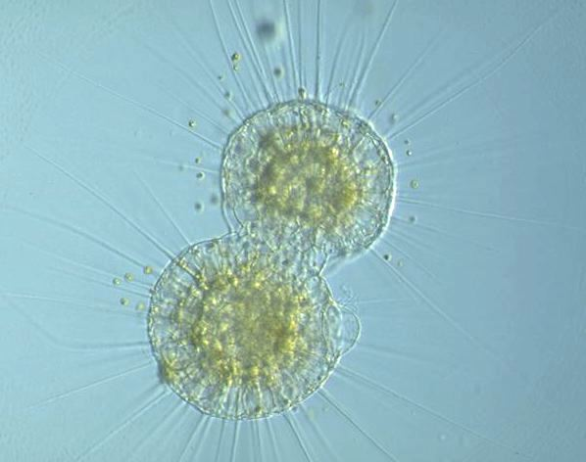
Cell Growth and Division
09-23-08

Slide 2
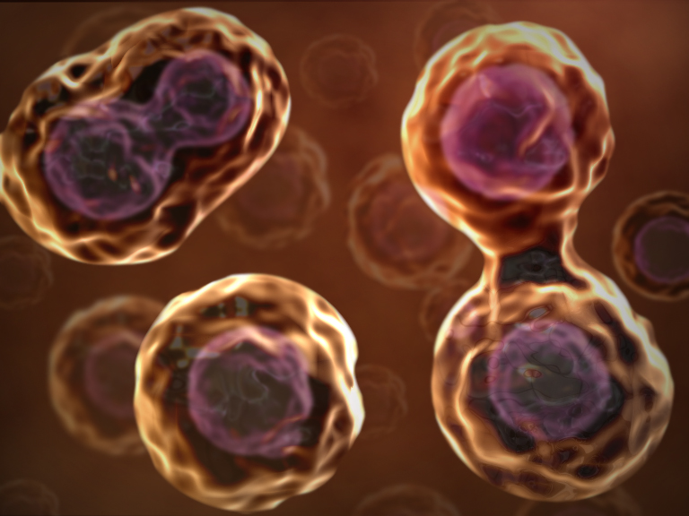
Cell Growth
Living things are made up of cells and living things grow, or increase in size
In most cases, a living thing grows because it produces more and more cells
The cells of a human adult are no bigger than the cells of a human baby, just more of them

Slide 3
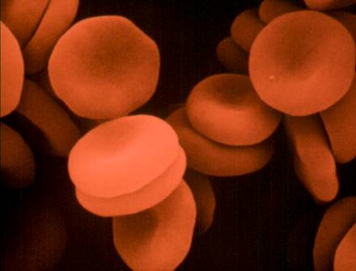
Limits of Cell Growth
Food, oxygen, and water enter the cell and waste leaves the cell through the cell membrane
How quickly this occurs depends on the surface area of the cell
How quickly food and oxygen are used up and waste products are produced depends on the cell volume
If we were to take a typical cell and double its diameter, what would happen to the amount of material inside of the cell?

Slide 4
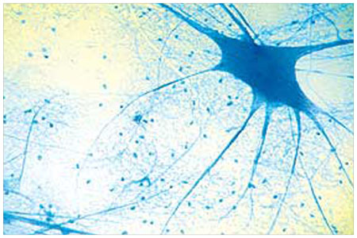
Limits of Cell Growth
The fact that surface area and volume do not increase at the same rate creates problems for the cell
The larger cell will have more difficulty than the smaller cell
A larger cell wall will have problems with materials entering and leaving the cell
This is one reason why cells do not grow much larger even if the organism they are a part of does

Slide 5
Limits of Cell Growth
Information for the cell’s function and survival is stored in the sequence of nitrogenous bases in DNA
In eukaryotic cells, the DNA is stored in the nucleus of the cell
When the cell is small, copies of DNA that are store in the nucleus are able to produce enough messenger RNA to make all the proteins the cell needs
If the cell increases in size, it does not make extra copies of DNA
If a cell were to grow without limit, an “information crisis” would occur
The cell must slow down its growth, becoming less efficient
The cell undergoes cell division to solve these problems
Cell division is the process whereby the cell divides into two daughter cells

Slide 6
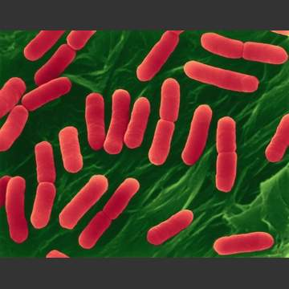
Rates of Cell Growth
Cells can grow at astonishing rates
E.coli (Escherichia coli) is a single-celled organism that can easily double its volume in about 30 minutes
It can then divide to form two new cells
If conditions are ideal, each of these cells can grow to form two new cells in 30 minutes
Ideal conditions for this kind of growth can never be maintained for very long

Slide 7
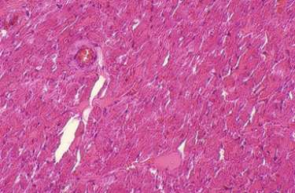
Controls on Cell Growth
One of the most fascinating aspects of cell behavior in a multicellular organism is how carefully cell growth and cell division are controlled
Cell in the heart and nervous system rarely divide, if they divide at all
Cells of the skin and digestive tract grow and divide rapidly throughout life, providing new cells to replace those that are worn out or broken down due to daily wear and tear

Slide 8
Controls on Cell Growth
You can observe the effects of controlled cell growth in the lab by placing some cells in a petri dish containing nutrient broth
Nutrient broth provides food for the cells
Most cells will grow until they form a thin layer covering the bottom of the dish
Why do the cells stop growing?
When cells come into contact with other cells, they respond by not growing
Currently, scientists are trying to understand how this process works

Slide 9
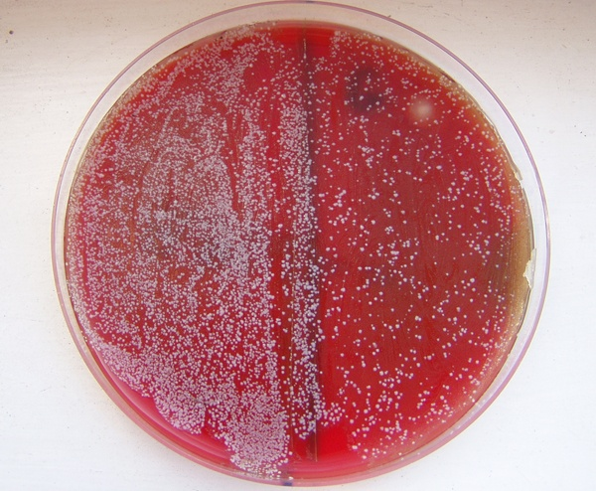
Controls on Cell Growth

Slide 10
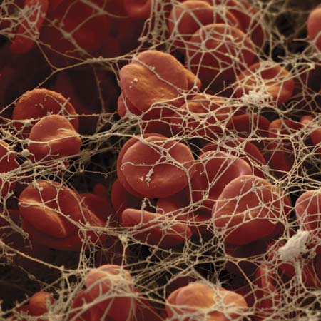
Controls on Cell Growth
controls on cell growth and cell division can be turned on and off
when an injury, such as a cut in the skin or a break in the bone, occurs, cells ate the edges of the injury are stimulated to divide rapidly
this action produces new cells, starting the process of healing
when healing process is nearly complete, the rate of cell division slows down, controls on cell growth seem to be reimposed, and everything returns to normal

Slide 11
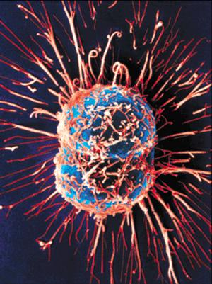
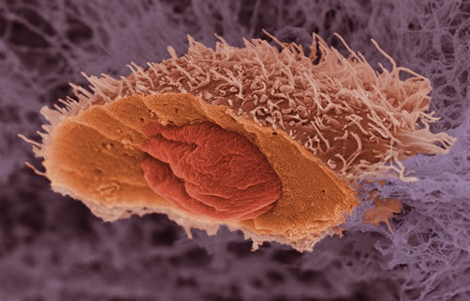
Cancer Cells

Slide 12
Uncontrolled Cell Growth
the consequences of uncontrolled cell growth in a multicellular organism are severe
Cancer, a disorder in which some cells have lost the ability to control their own rate of growth, is one such example
When cancer cells are placed in a culture of living tissue, they do not stop growing even though they come into contact with other cells
Cancer cells will continue to grow and divide until the supply of nutrients is exhausted
Cancer is a serious disorder that claims the lives of many and affects all of us, directly or indirectly
Cancer provides valuable info to cell biologists concerning the importance of controls on cellular growth

Slide 13
http://www.youtube.com/watch?v=aDAw2Zg4IgE

